Slide 1
The bases

Slide 2
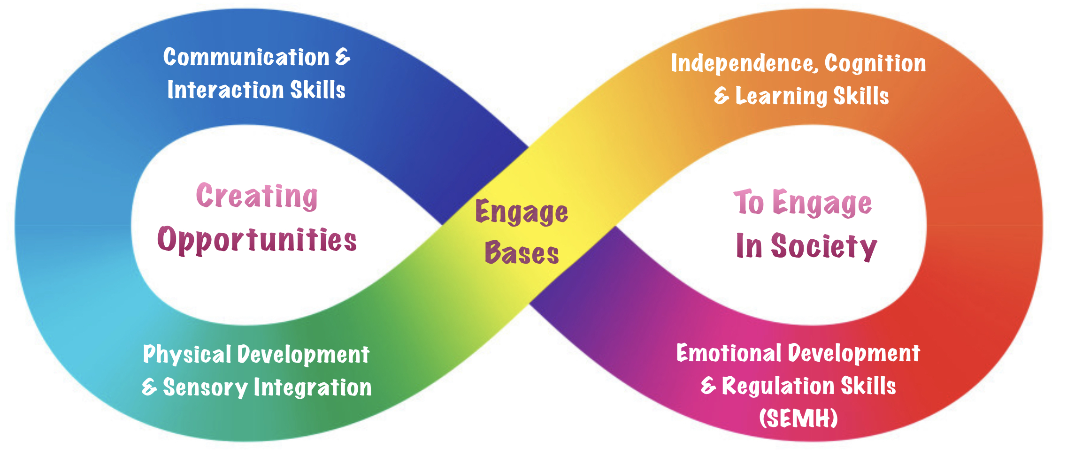
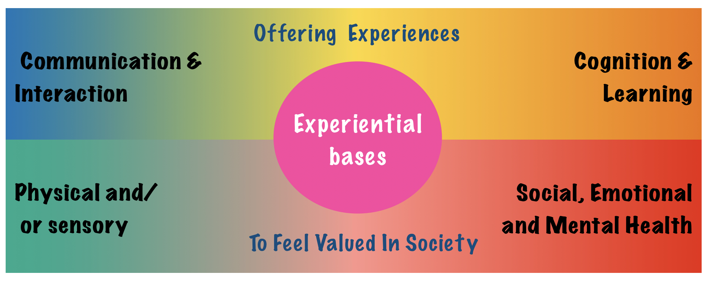
All students in the bases (EXB & EnB) have complex learning needs often working below the national curriculum assessment standards. They need specific support with their communication, social interactions and LifeSkills, therefore, requiring a static model with a holistic/ person centered assessment system (MAPP) compared to a more traditional curriculum model.
Students in the Engage Bases (EnB) also MAY:
- have a diagnosis of Autism and/or display ‘classically autistic’ traits, where specialist ASC/ motivation strategies such as ‘work first, then choose’ are needed
- need specific support including sensory integration to regulate their emotions/ challenging behaviour
- benefit from a more structured environment with smaller group sizes, consistent staffing & routines where possible
Students in the Experiential Bases (ExB) also MAY:
- require a multi sensory approach to learning
- may also have complex physical and/or medical needs.
All students are assessed using the Mapping & Assessing Personal Progress (MAPP) under the following areas:
Students are grouped based on need and personality - not always academic levels or age.
Communication
& Interaction
Social,
Emotional
& Mental
Health
Cognition & Learning
Sensory
and/or
Physical
In some cases a blended approach of ExB and EnB strategies may be required to fit individual students needs.
Targets are assessed using the following:
Independence - Fluency - Maintenance - Généralisation

Slide 3
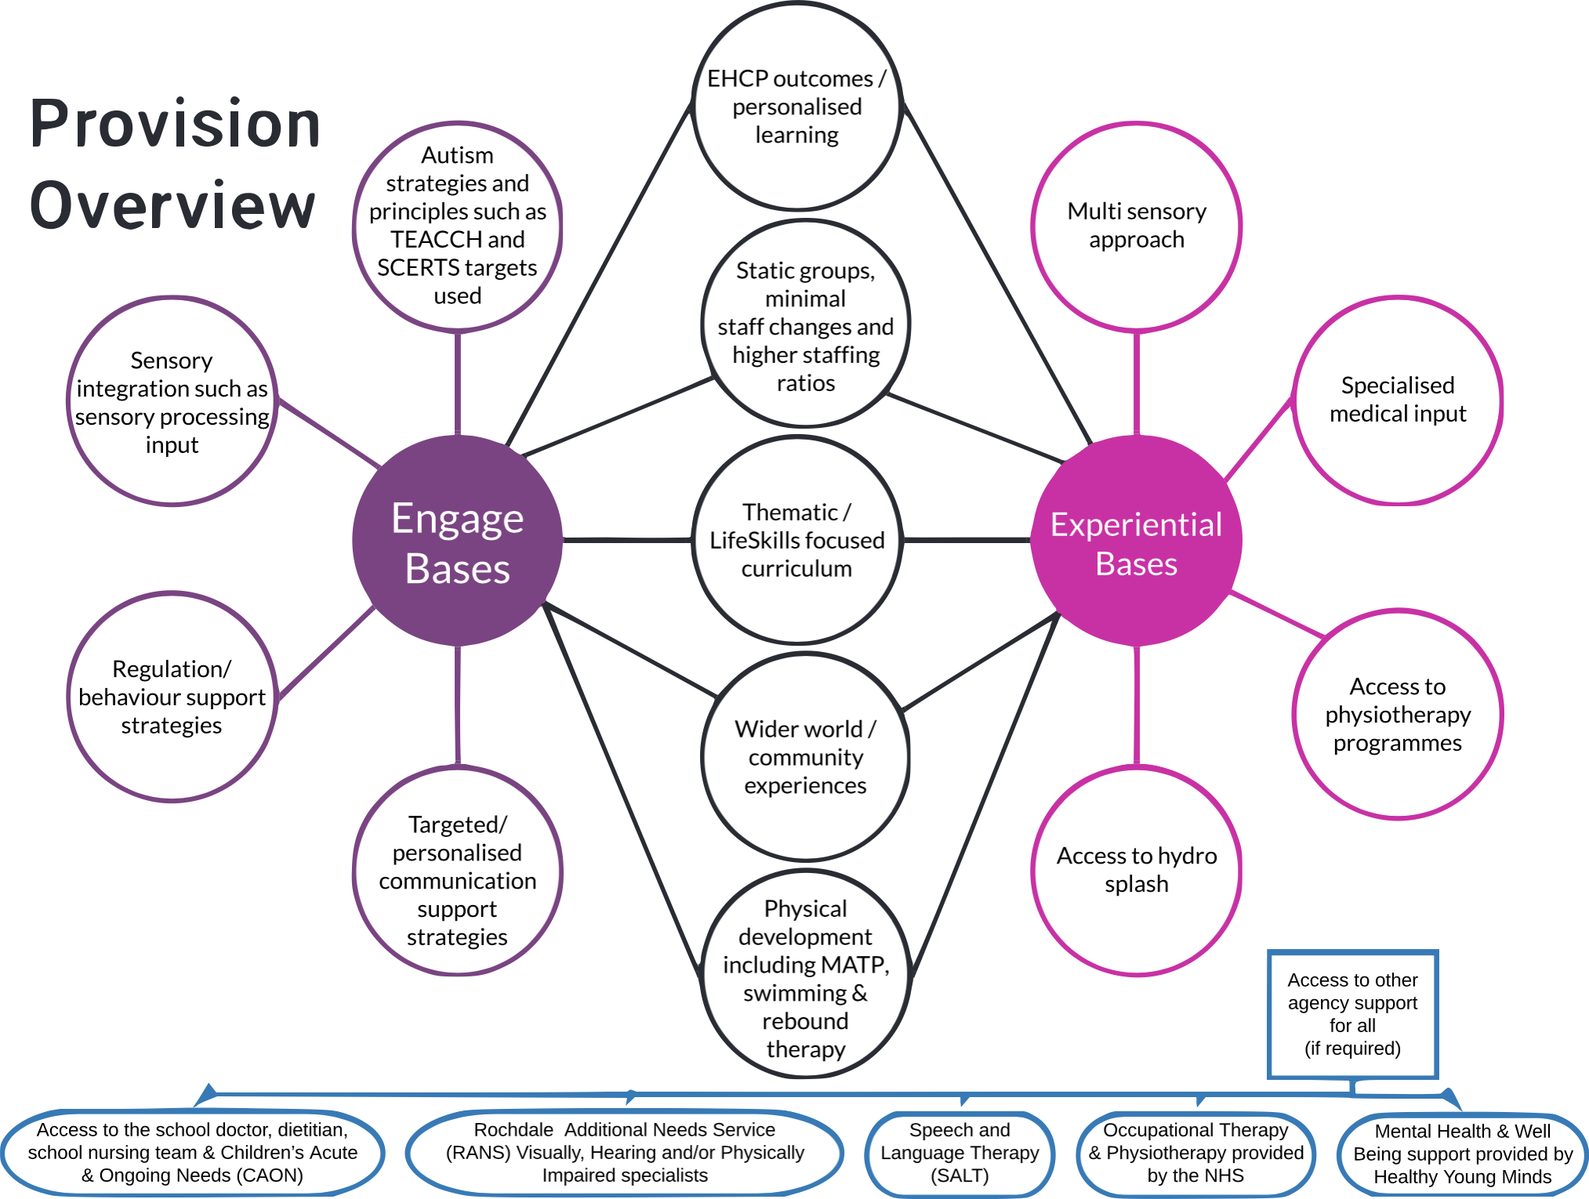

Slide 5
Engage bases
Engage pathway

Slide 6
The engage pathway rationale
 | Engage pathway rationale/ overview​
Vision | To provide all students who access the Engage bases the tools and skills to prepare them for adulthood. By using holistic, personalised learning and target setting in conjunction with a high-quality nurturing environment, we give them opportunities to develop their personal growth, enabling them to engage successfully in society as well as reducing anxieties and/or challenging behaviours.
Intent | In the Engage bases, we use holistic, personalised learning and target setting to focus on promoting student engagement, self-regulation, building relationships, developing independence and meaningful LifeSkills. We have 4 key principles that we focus on within all our bases: ​ Communication & Interaction Skills- Emotional Development & Regulation​​ Skills Physical Development & Sensory Integration Independence, Cognition and Learning Skills By focusing on these key principles, as well as setting personalised targets to scaffold and sequence progress towards personal Education, Health and Care Plan (EHCP) outcomes: we ensure all students feel valued, become as independent as possible, as well as empowered to express themselves in safe and meaningful ways.
Implementation ​ | Students are grouped according to need, alongside behaviour and personality. This means that groups are not in academic levels or age and are predominately based in static groups/rooms. Groups have a higher level of staffing to provide as much stability as possible. They have access to shared resources such as the hydrotherapy pool, swimming pool and sports hall. We also take opportunities to engage with the local community as much possible. Where possible, flexible student-centred activities and approaches are used. Learning activities are based on thematic learning and integrate functional literacy and numeracy. Autism principles are utilised within the bases, such as elements of TEACCH including: ‘Work first then choose’ , Structured low stimulus environments, visual timetables and supports. Sensory integration (including sensory diets/ snacks) is also integral to how we plan and deliver sessions, ensuring we meet our learners' sensory needs as well as develop their emotional and physical responses to everyday environmental stimuli. Our learning programme is planned and designed by the teacher in relation to personalised learning intentions. We use the student’s EHCP outcomes as our fundamental starting point which are categorised into 4 areas of the SEND code of practice - Communication and Interaction - Cognition and Learning - Emotional and Mental Health – Physical and/or Sensory. To allow students to achieve these outcomes and their subsequent annual review targets we sequence smaller personalised learning intentions using the Mapping Assessing Pupil Progress (MAPP) assessment tool. Where appropriate, to aid our learners, we may also utilise targets taken from - Social Communication, Emotional Regulation and Transactional Support (SCERTS). Students intentions are assessed using following the following criteria: Independence - Prompting and increasing independence. Fluency - Fluency is about combining speed and accuracy. Maintenance - Maintenance is about becoming more consistent over time. Generalisation -Generalisation is about performing in different settings with different people.
Impact​ | To have given students as many opportunities as possible as well as ensuring they reach adulthood with reduced stress and anxieties whilst maintaining their uniqueness. To ensure this, they will have been given opportunities to develop and practise communication, regulation and independence skills in safe ways thus enabling them to access the wider community and society in whichever way is best for them.

Slide 7
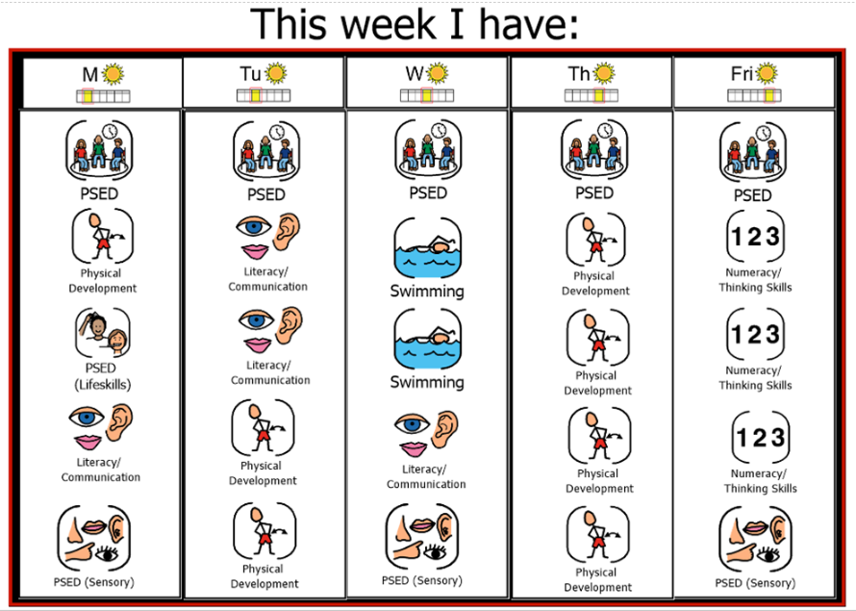
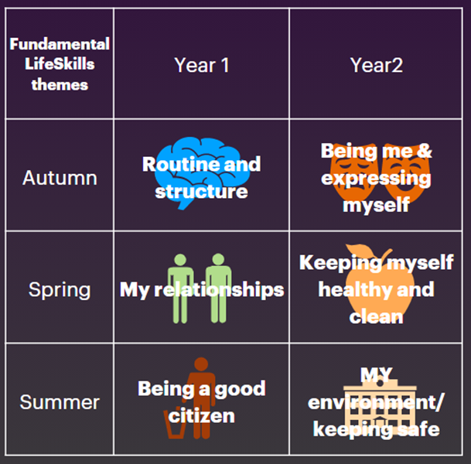
Example timetable, session titles & themes
Numeracy/ Thinking skills
LifeSkills and morning routines
Lifeskills topic
Numeracy
Creative ICT
PSED –
Self regulation and decompression time
Literacy/ Communication
Communication & interaction
Sensory story (theme)
Literacy
Physical Development / sensory
MATP
MADD (theme)
STEM/ sensory cooking
Swimming
Space
& History

Slide 8
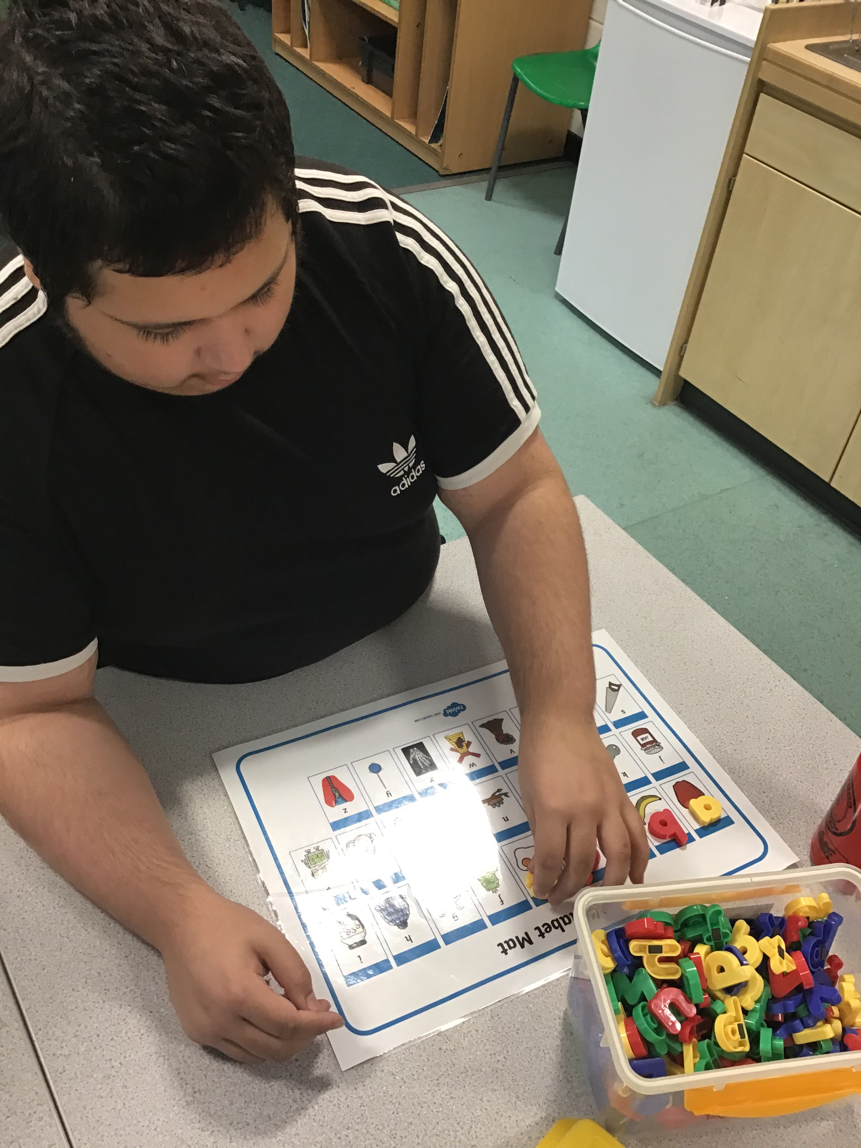
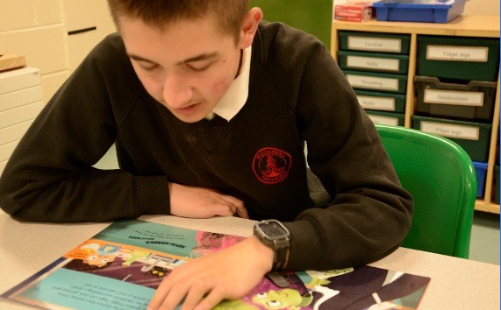
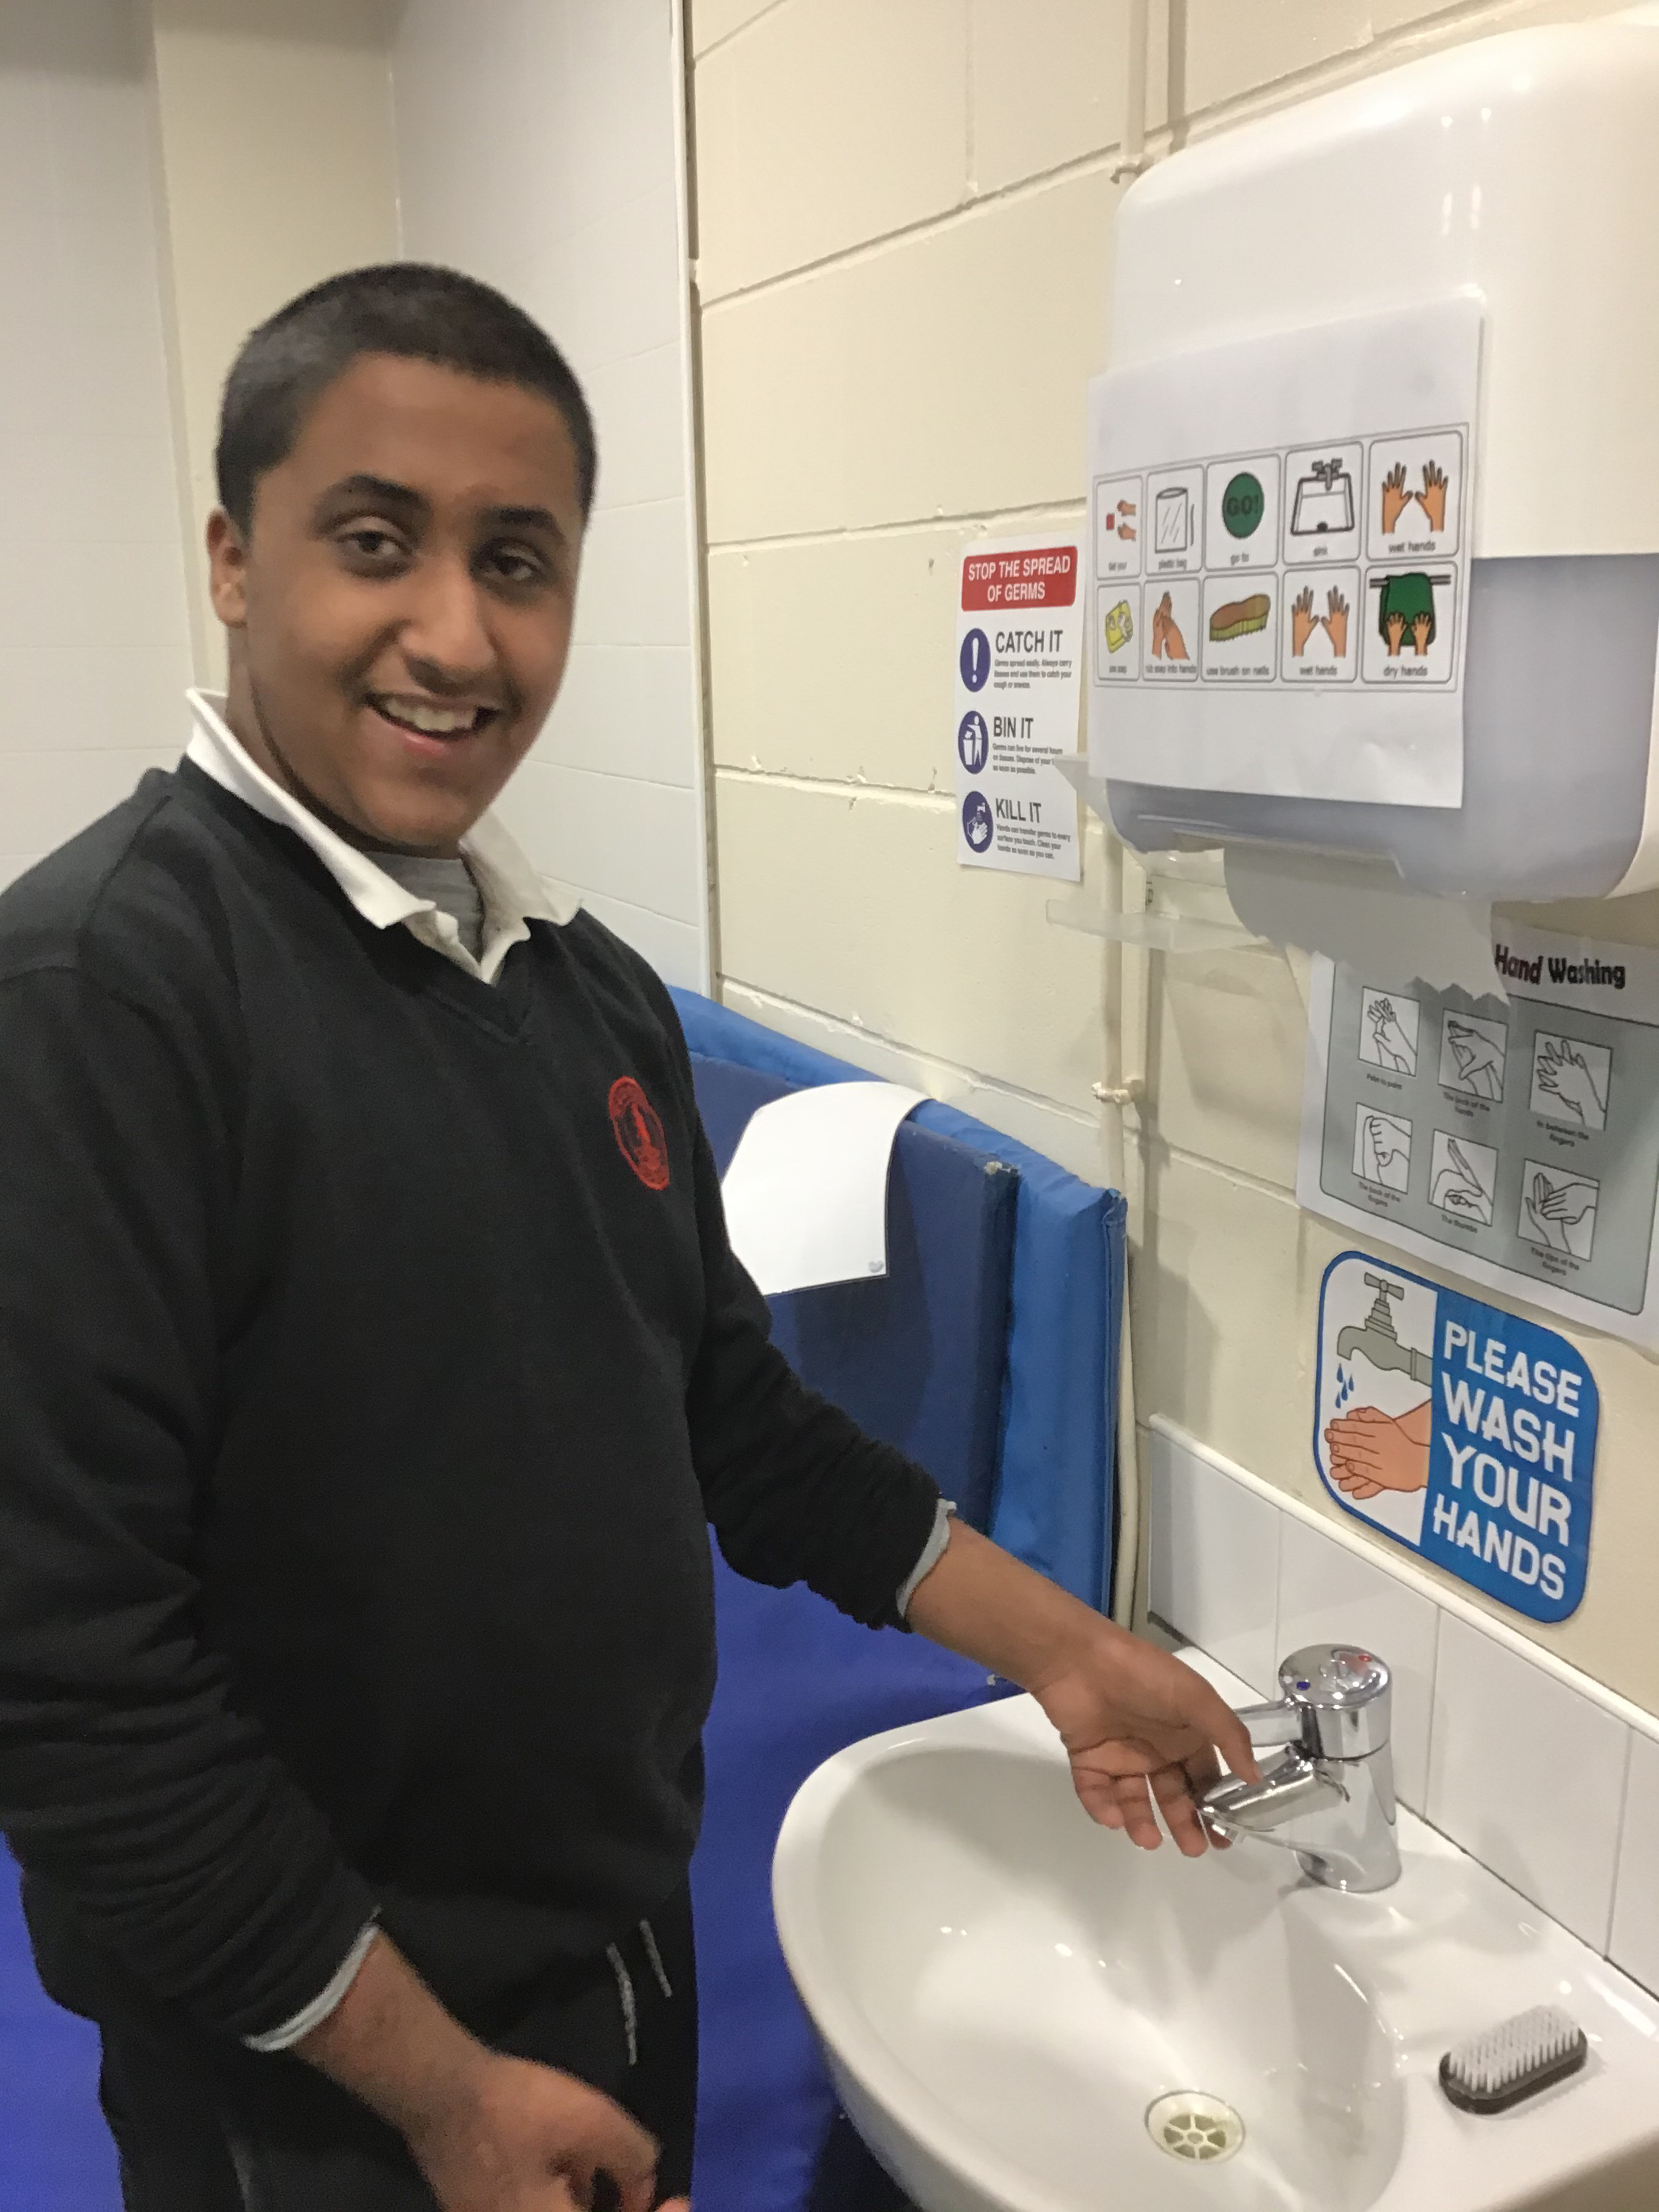
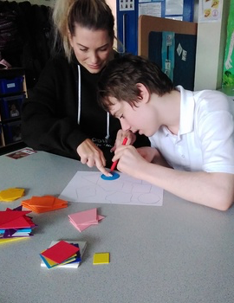
Look at what we can do:-

Slide 9
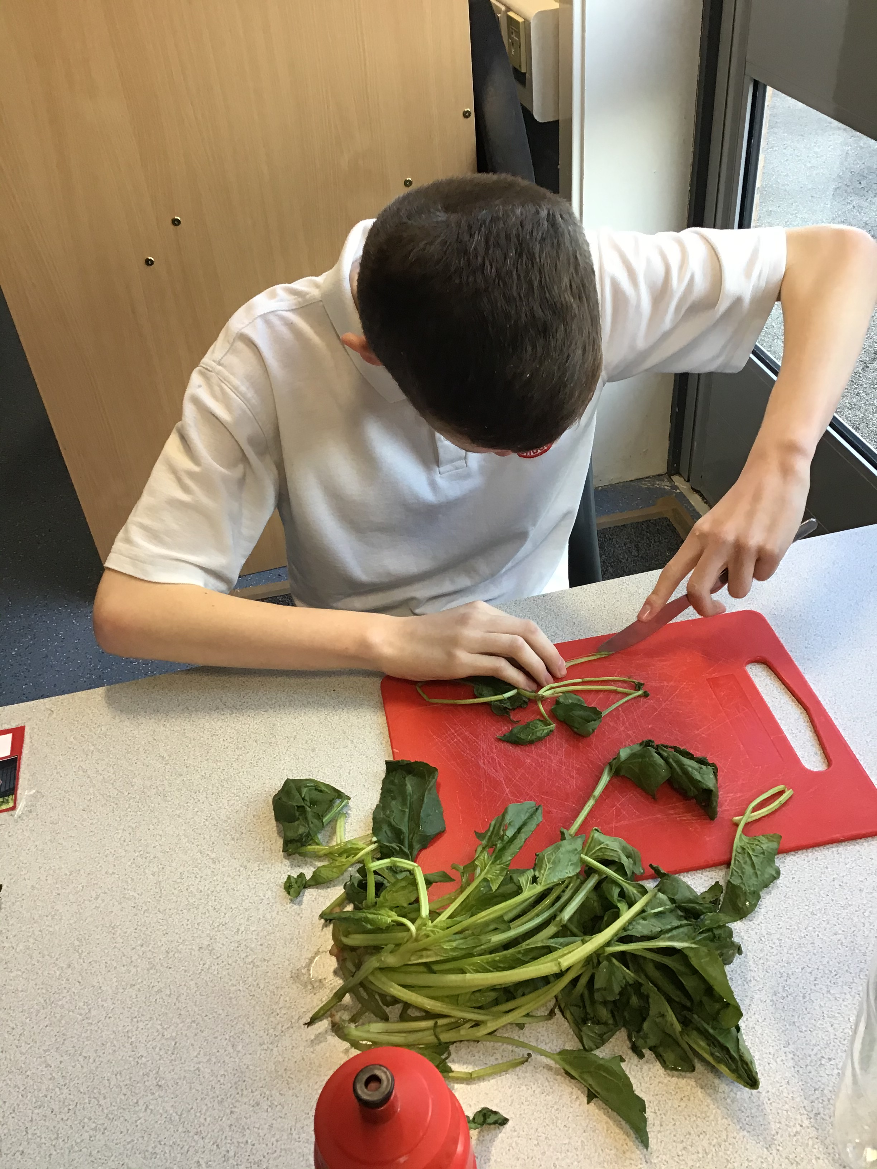
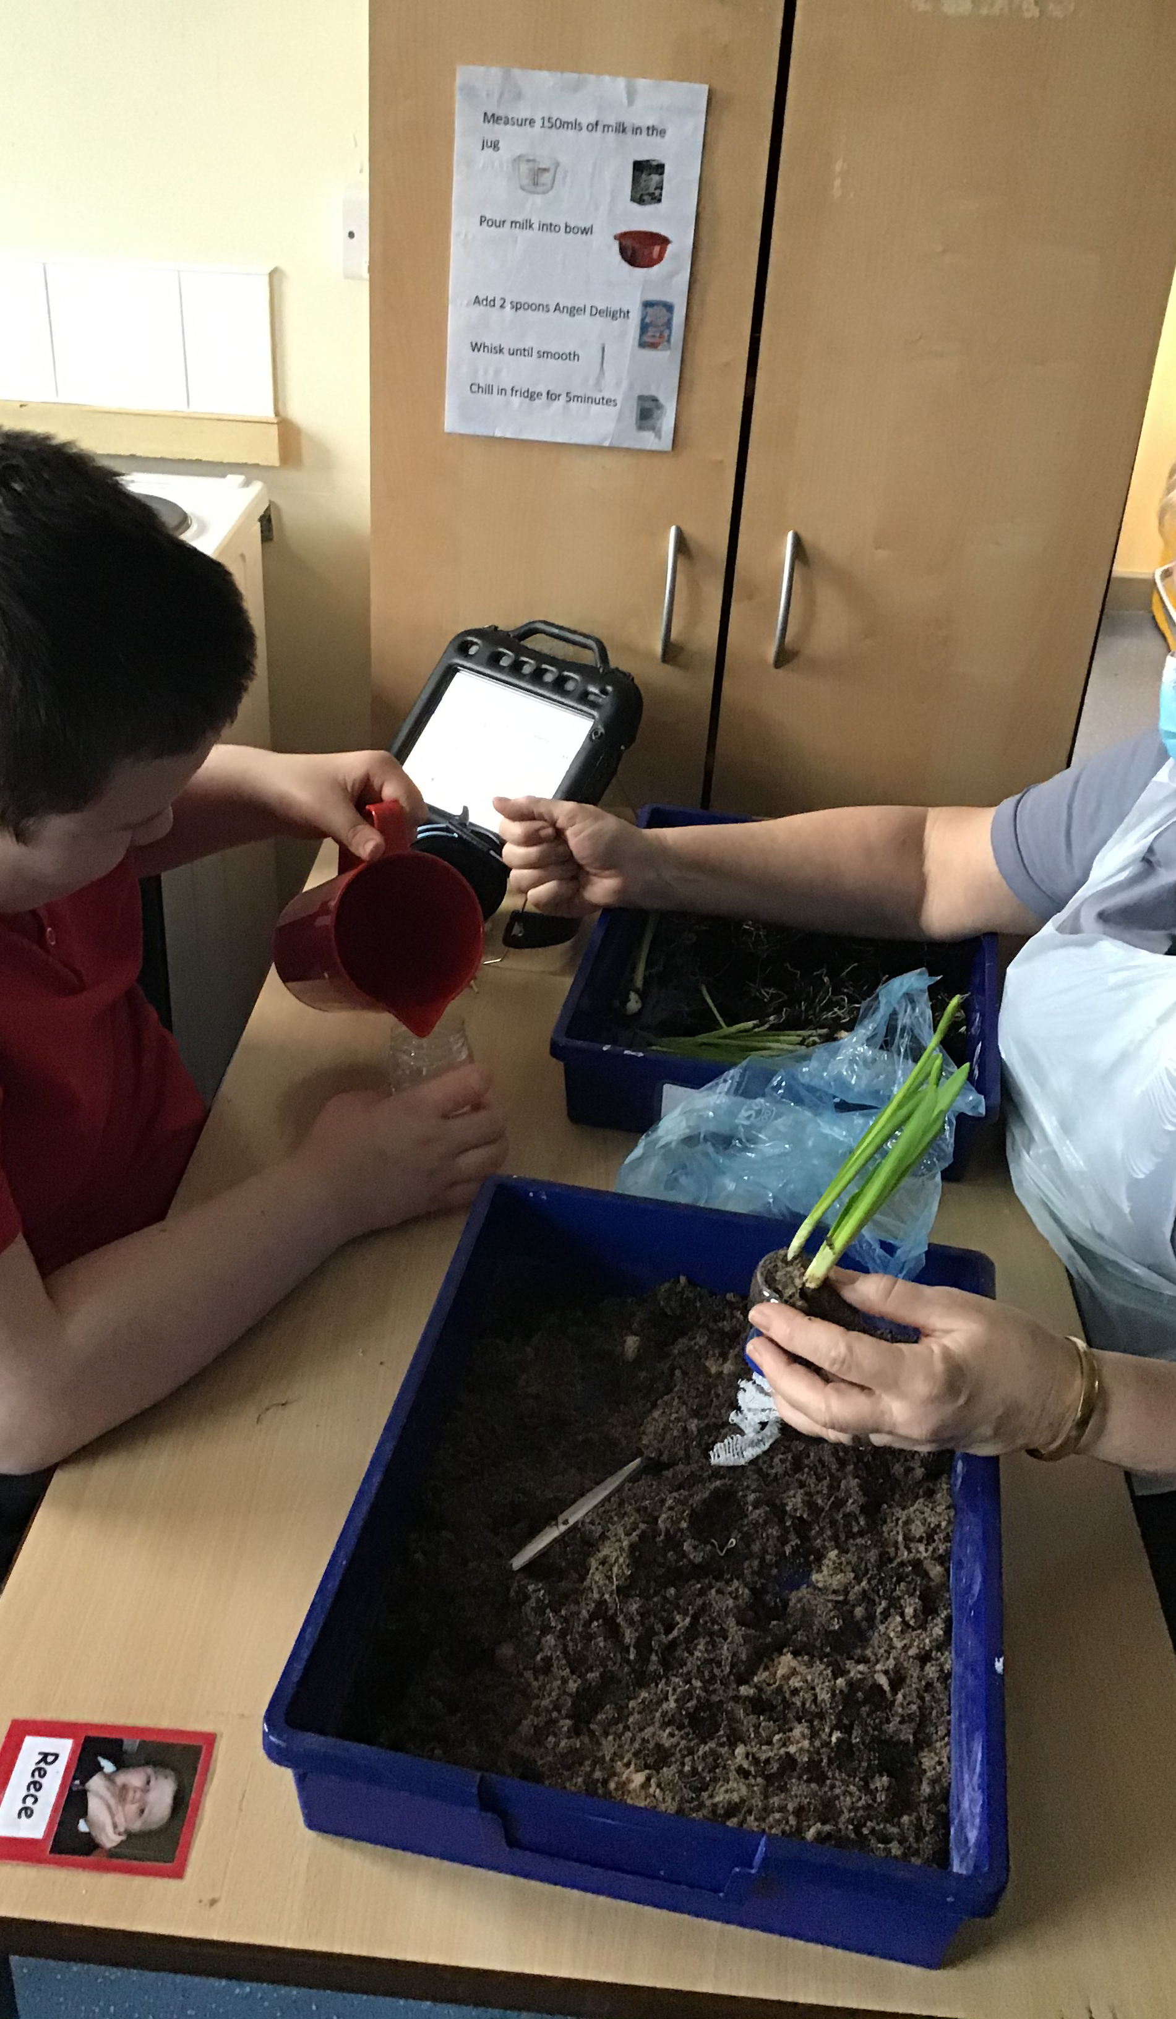
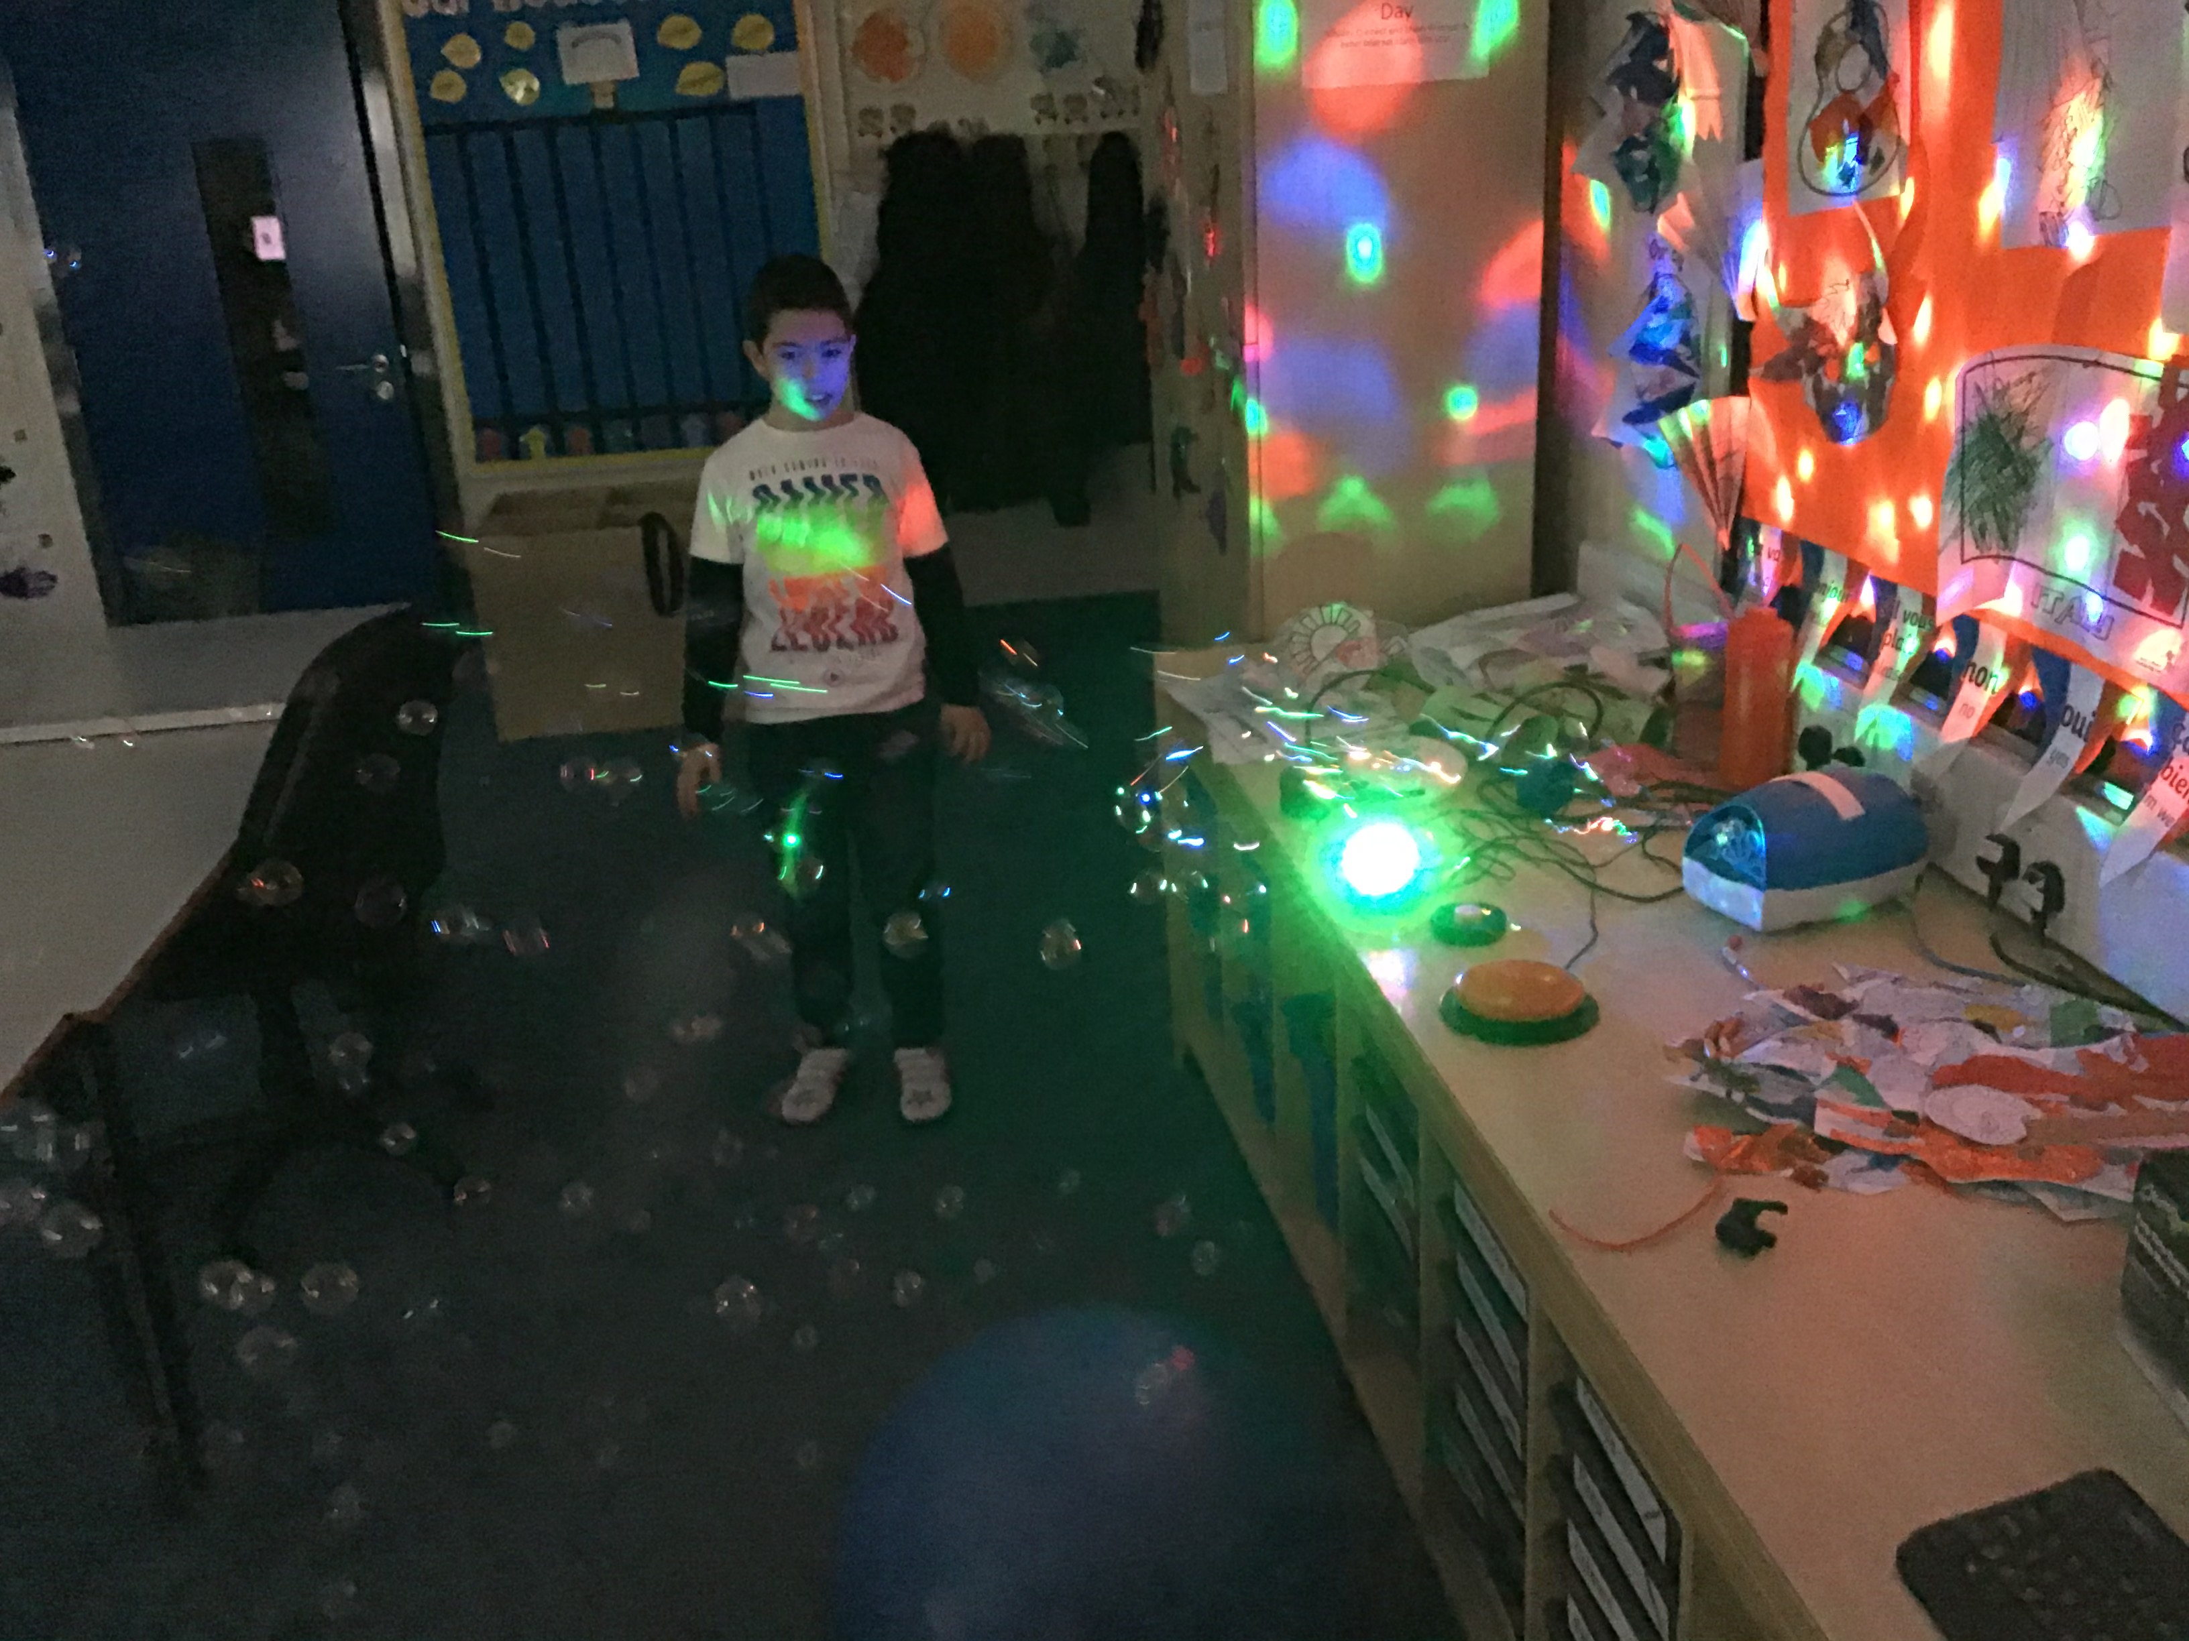
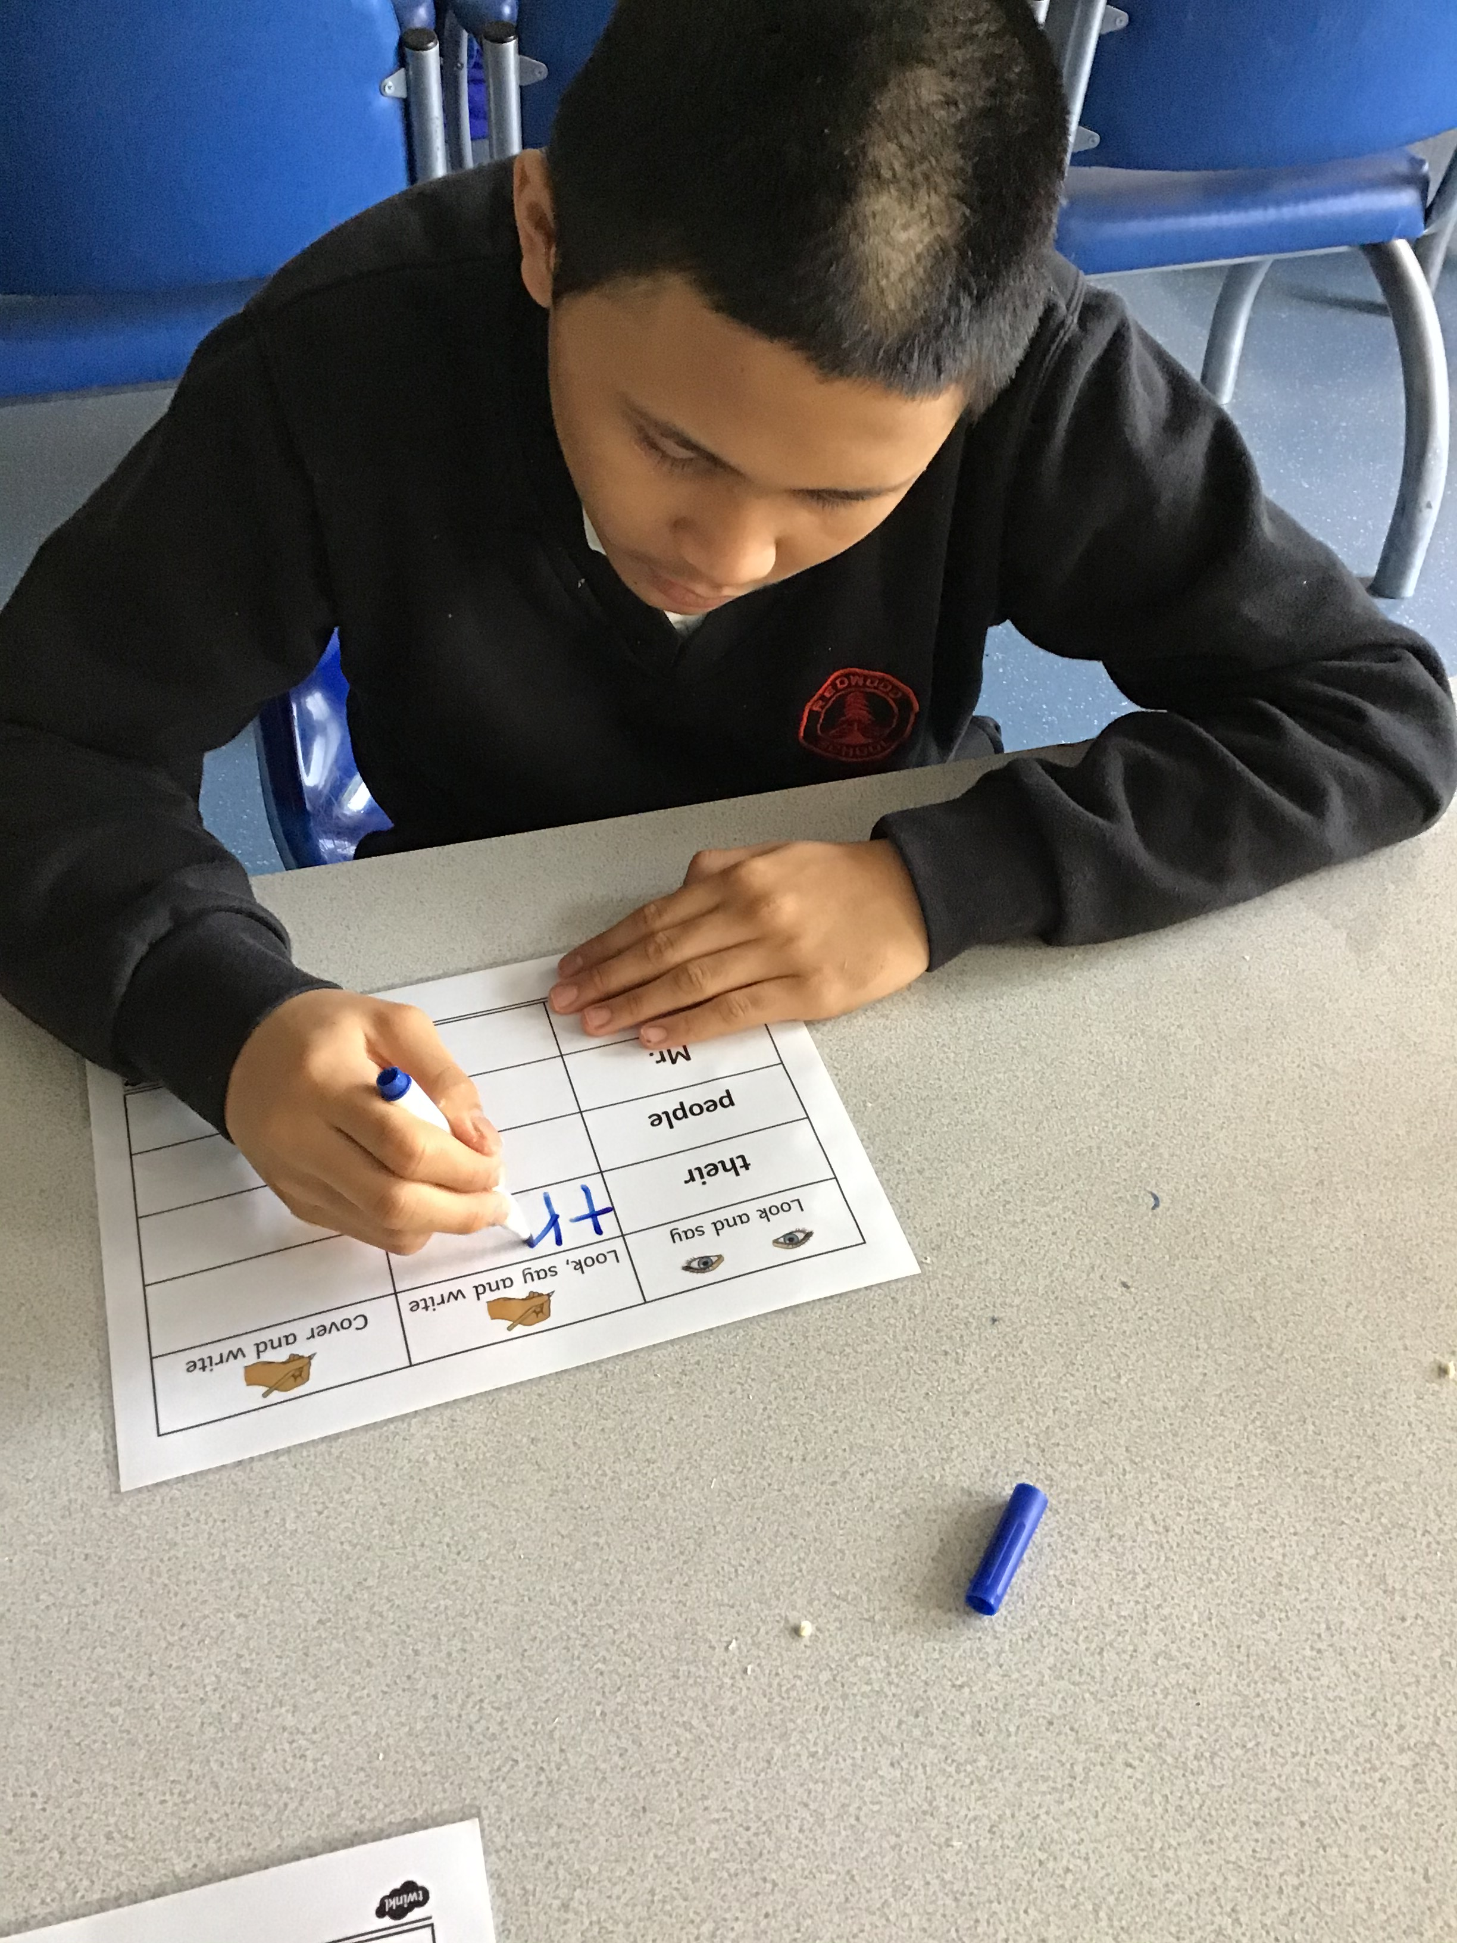
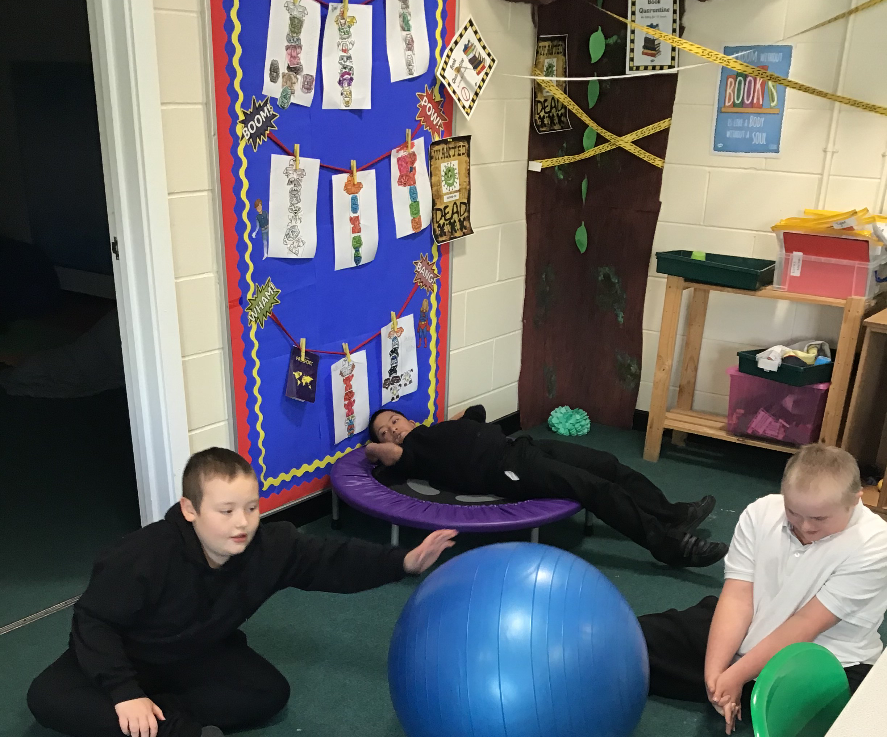

Slide 10
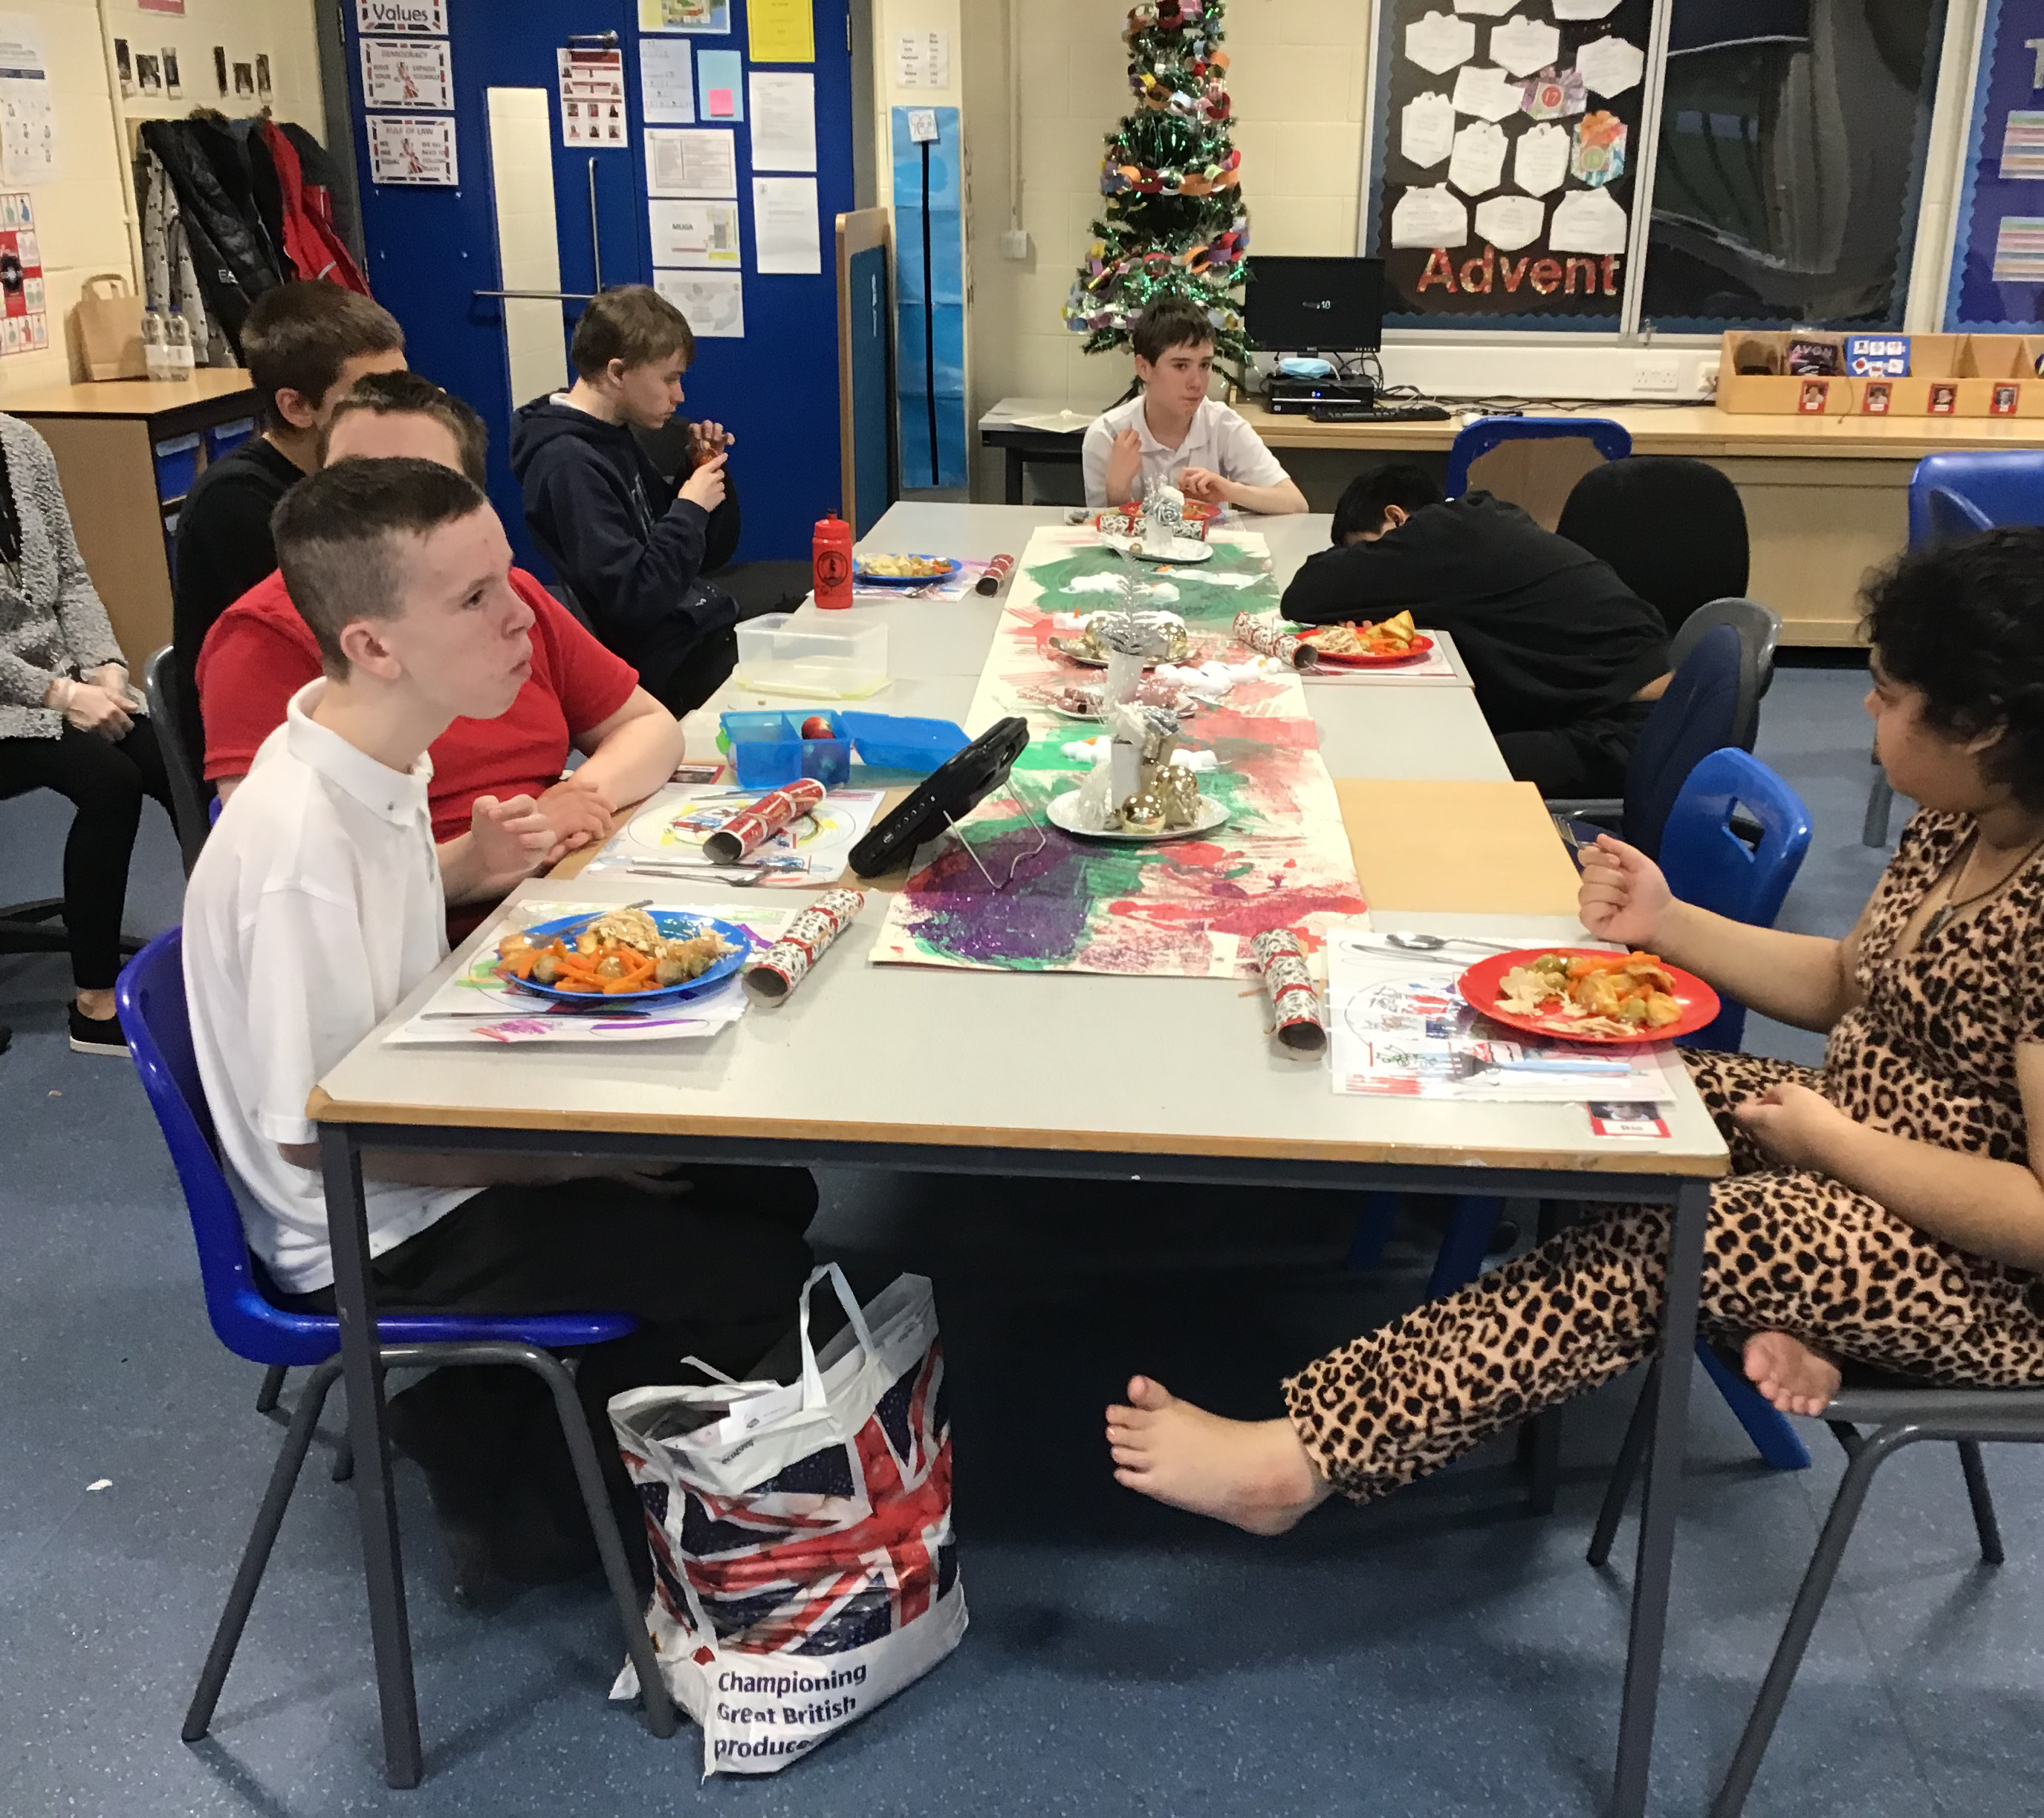
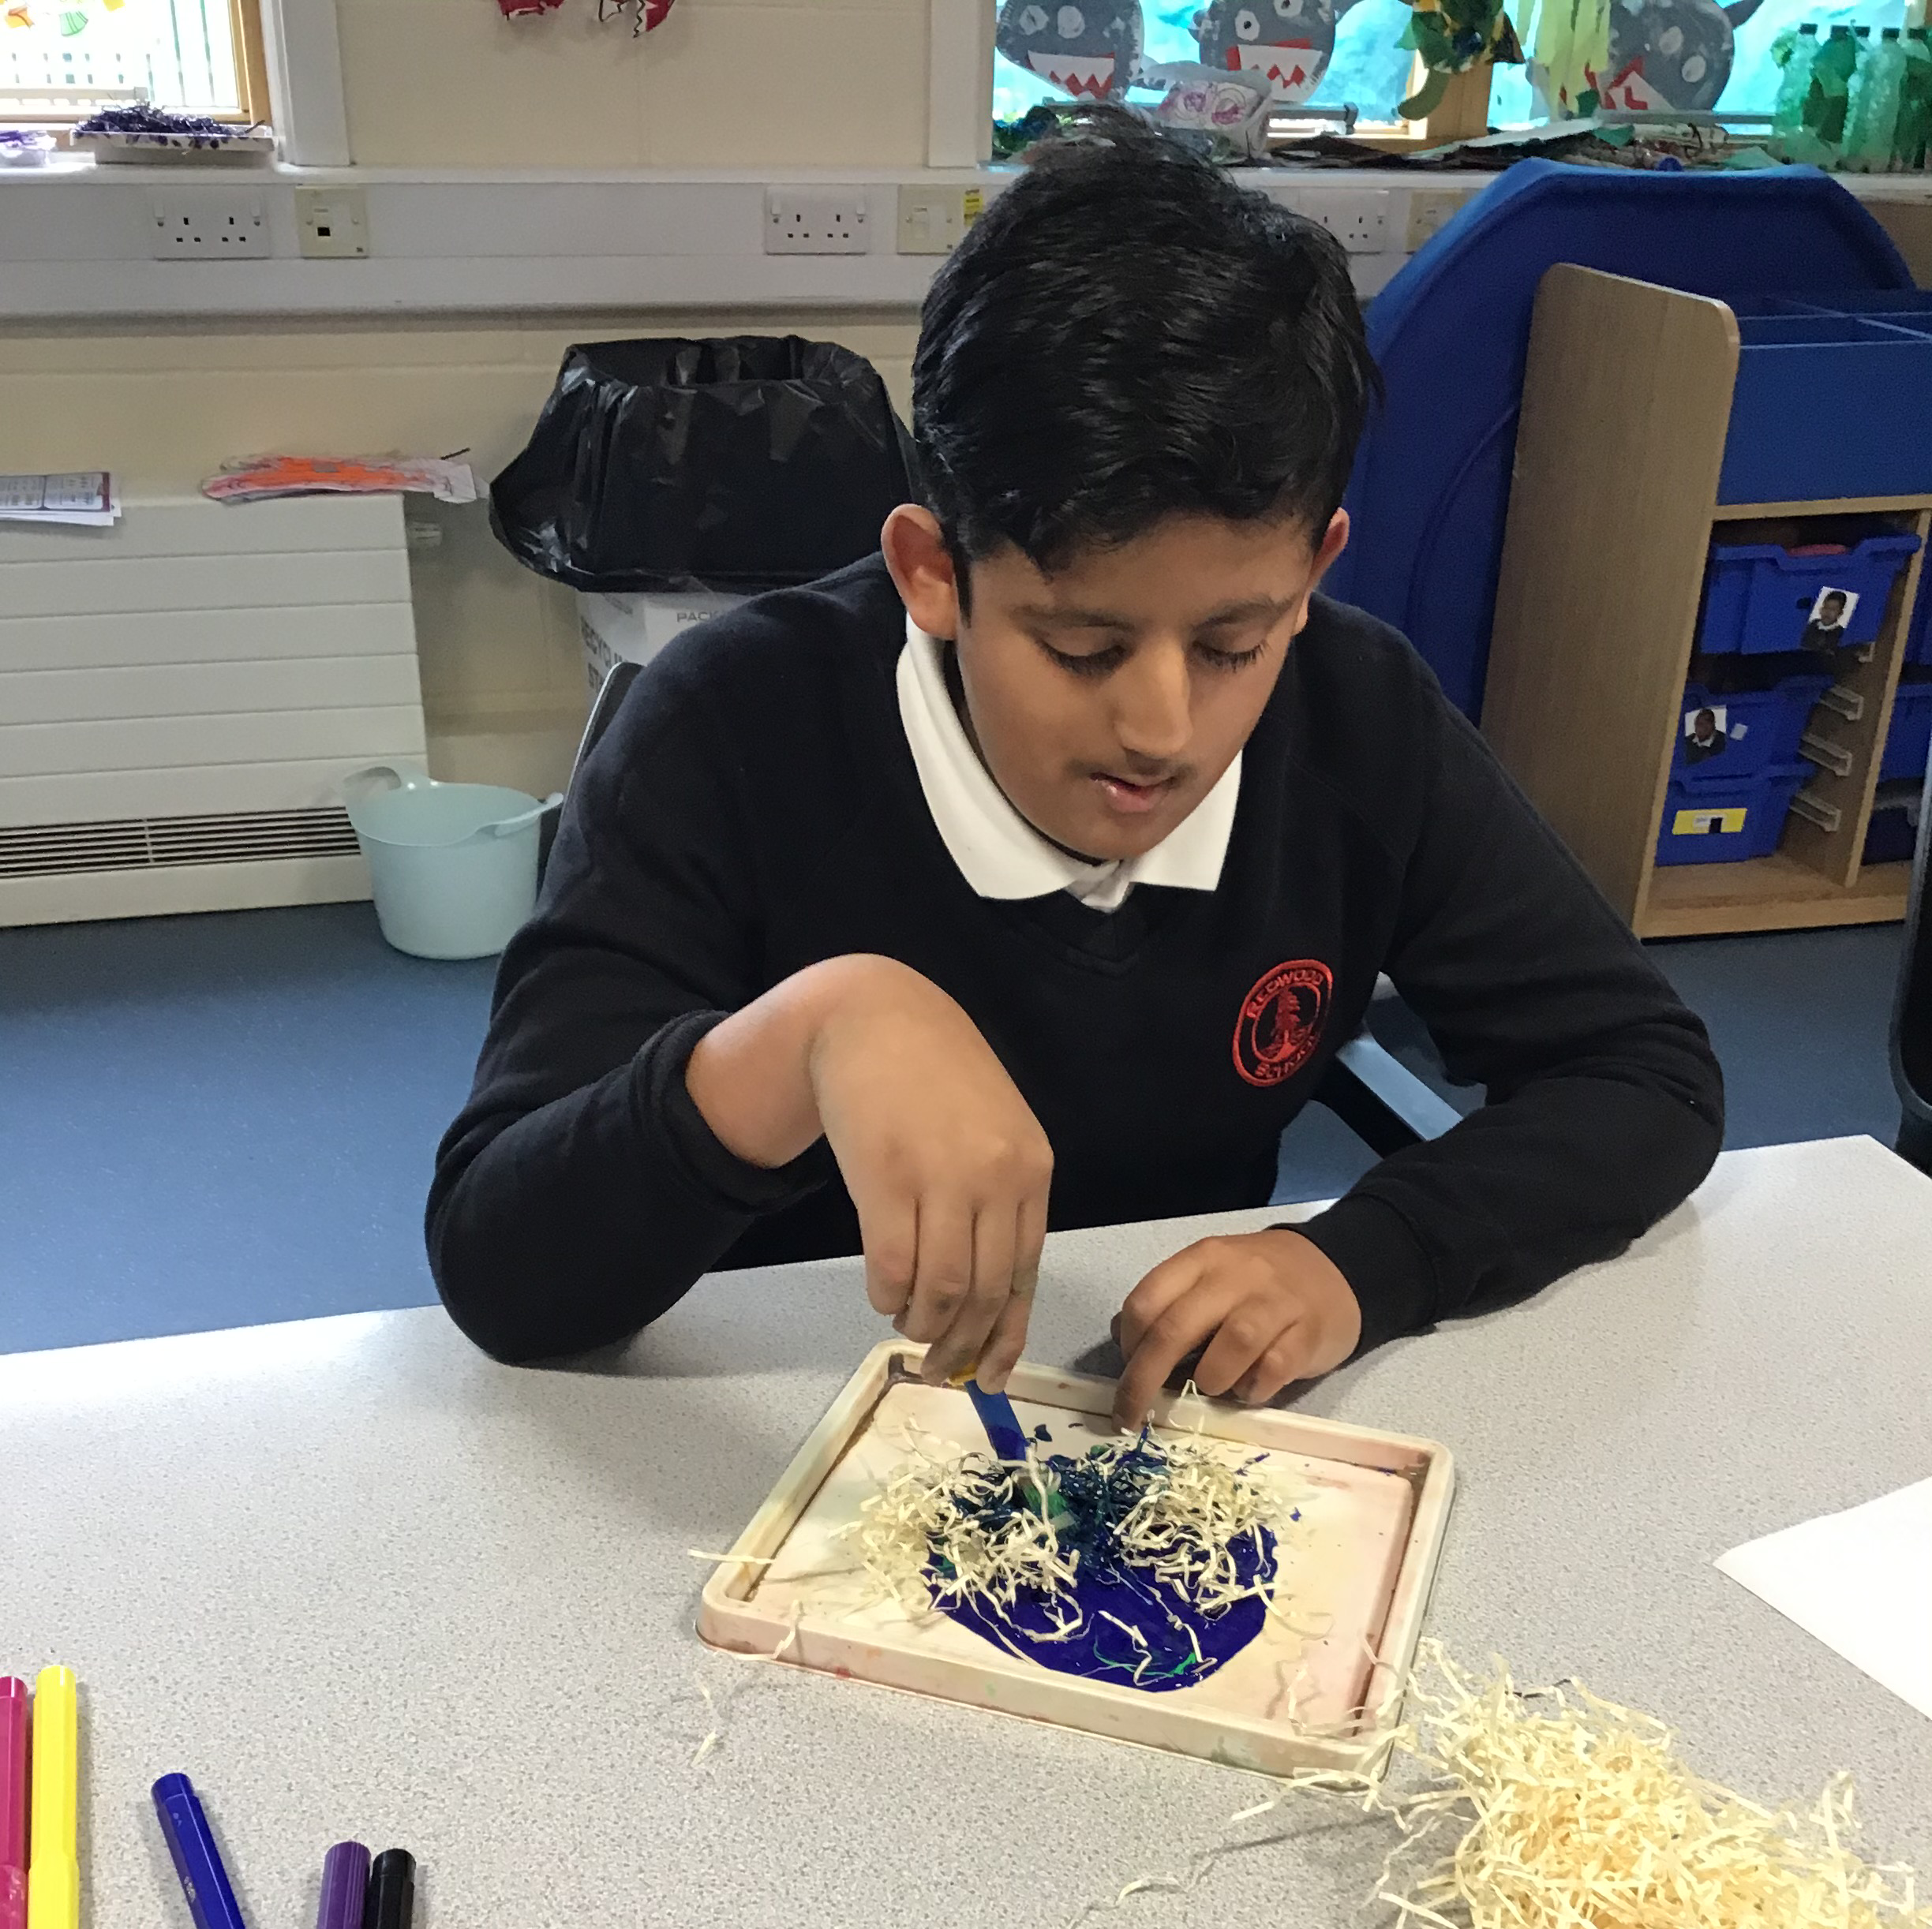
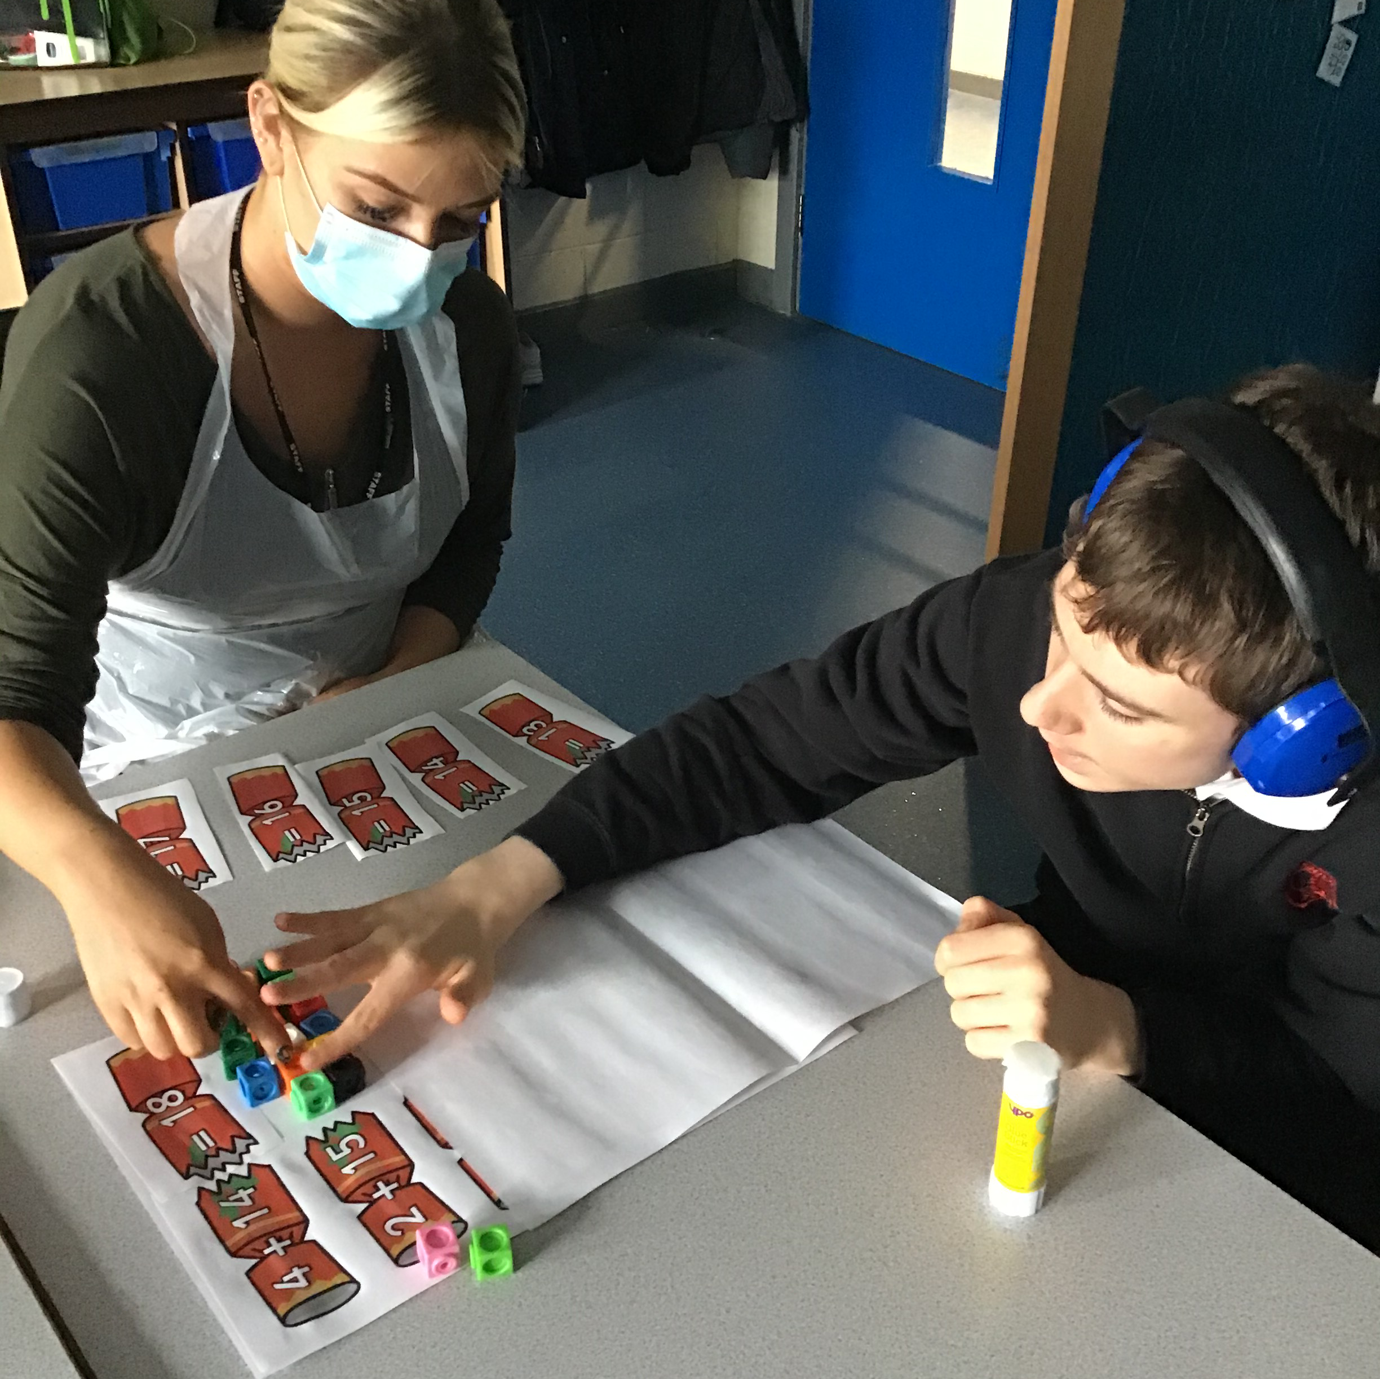
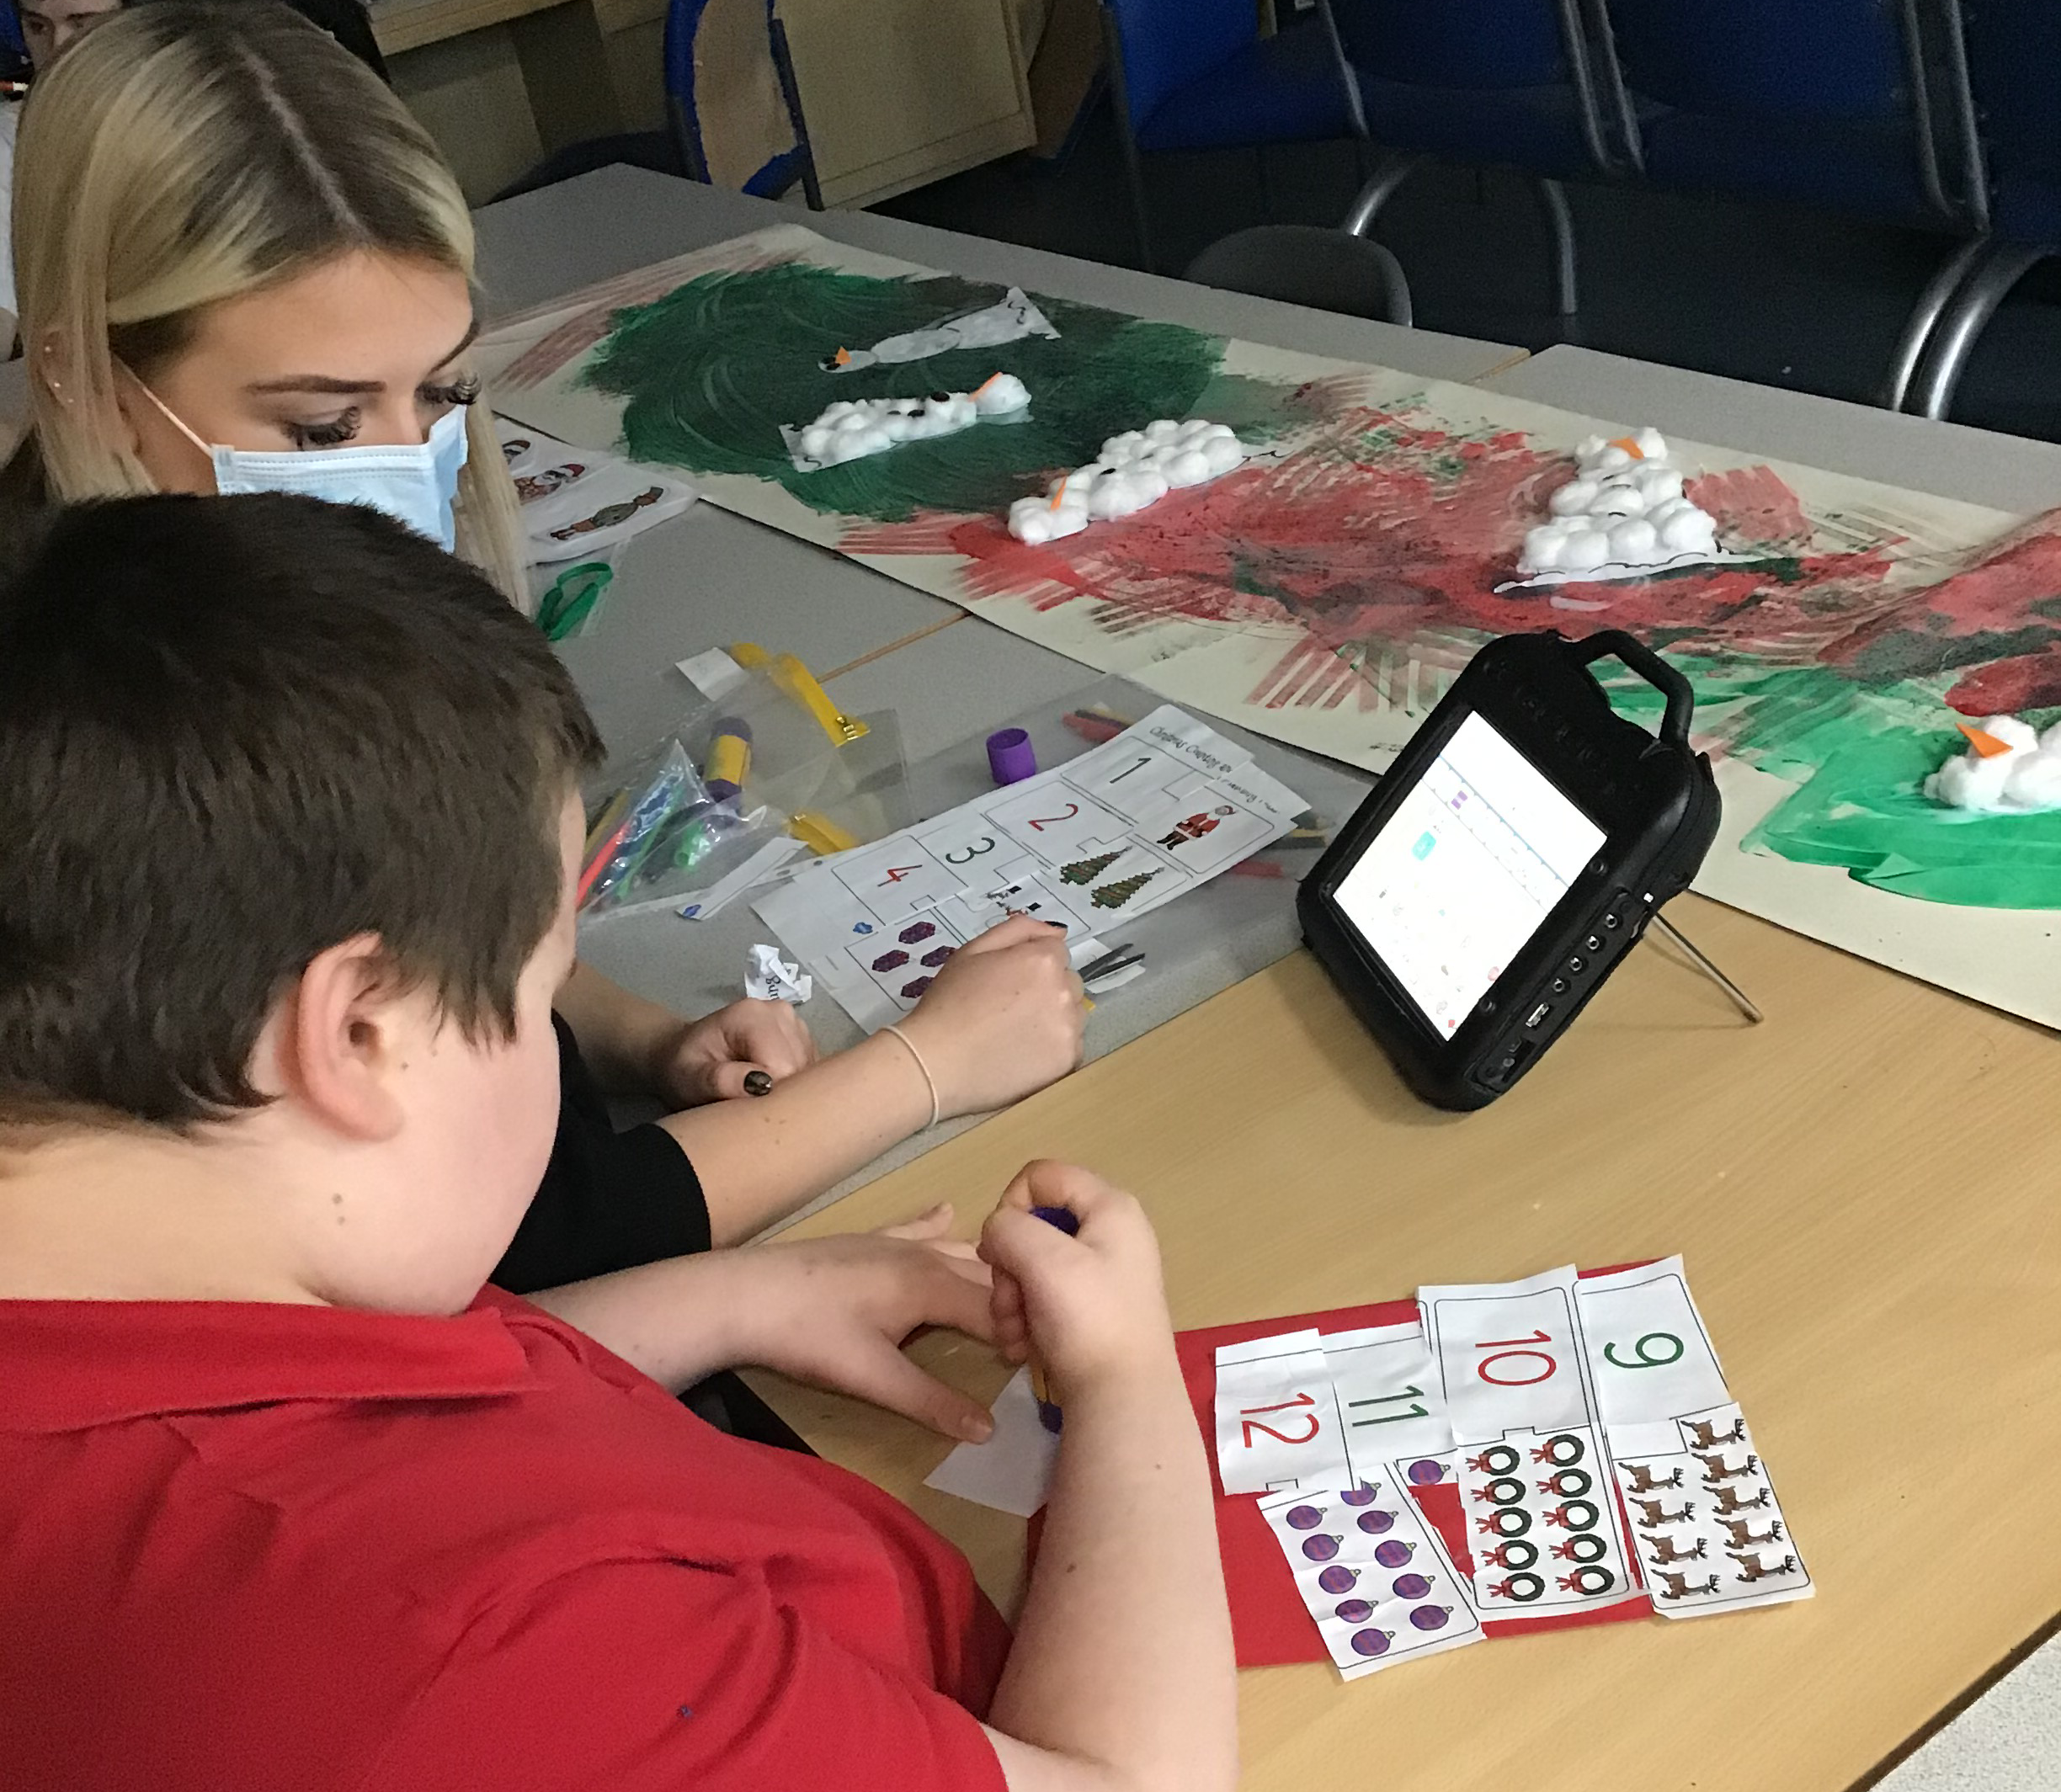

Slide 11
Experiential bases
Experiential pathway

Slide 12
The Experiential bases
The Experiential Pathway is a highly personalised multi-sensory curriculum for students with profound, multiple and / or complex learning, physical and / or medical needs.
Students on this pathway usually stay at Redwood from Year 7 – 14 and are grouped according to age and / or level of needs. Class sizes are small (between 6 and 8 students) and there is a high level of adult support to give the students the best opportunities to engage and achieve their goals and aspirations.
Students are set up to 8 personalised learning intentions per term and the EHCP outcomes play an integral part in the creation of learning intentions.

Slide 13
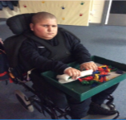
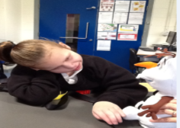
Experiential Bases
Sensory Experiential Curriculum model
4 Core Strands: -
Communication
Thinking Skills
Personal, Social and Emotional Development
Physical Development
A four year thematic approach is used as a vehicle to enable students to work towards and / or reach their learning intentions.
There are no set subjects and no learning intentions relating to specific subjects.

Slide 14
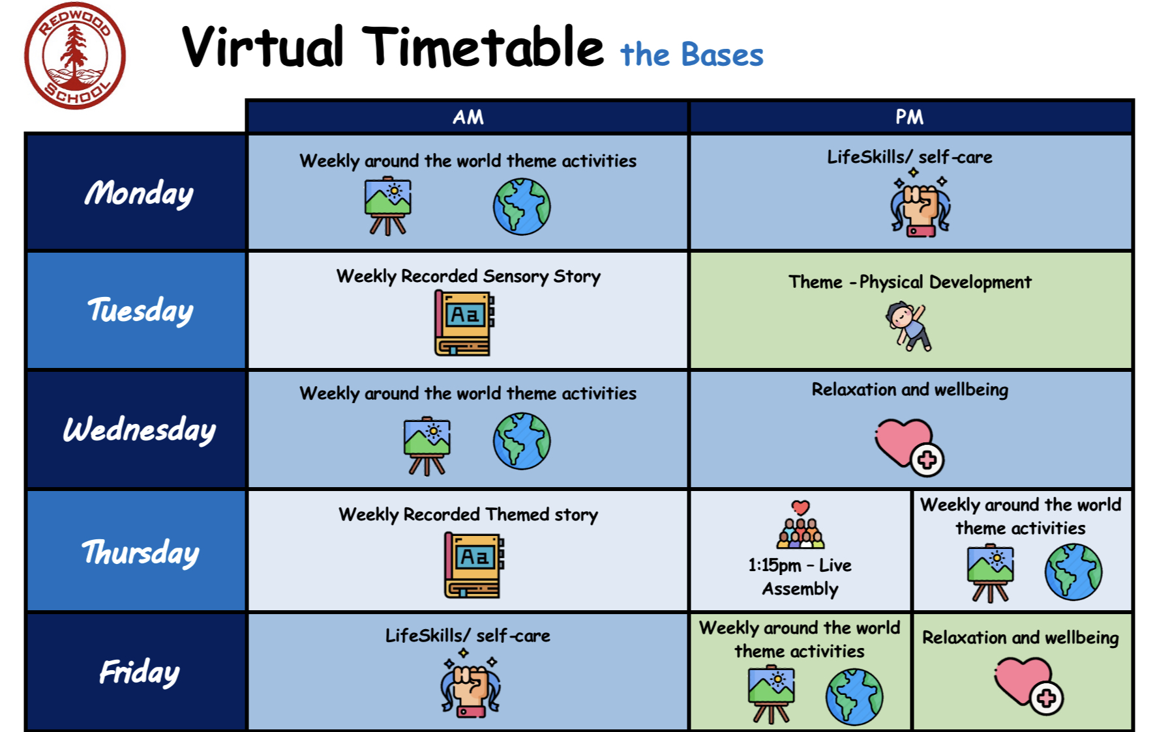
Example timetables
 | 9.10am – 10am | 10:00-10:50 | 11.05 – 11.55 | 1:10-2:00 | 2:00 – 2:50
Mon | Routines and SI with communication | Routines and SI with communication | Routines and SI with communication | ICT | ICT
Tues | Art | Art | Art | Music | Music
Wed | MATP | MATP | MATP | Wheelchair Dancing | Wheelchair Dancing
Thurs | Life Skills | Life Skills | Life Skills | Tac Pac | Tac Pac
Fri | Communication and SI | Communication and SI | Communication and SI | Leisure | Leisure

Slide 15
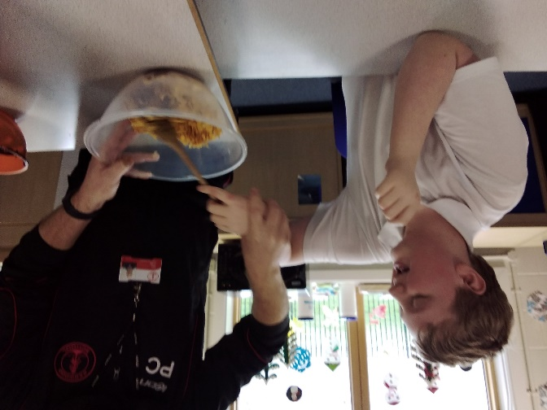
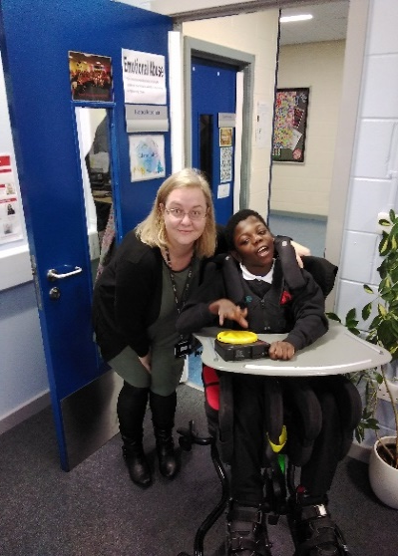
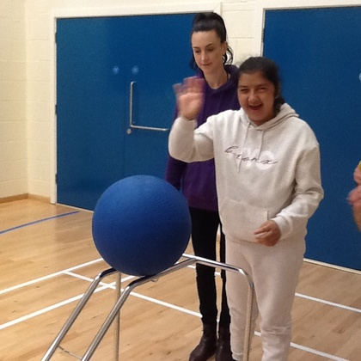
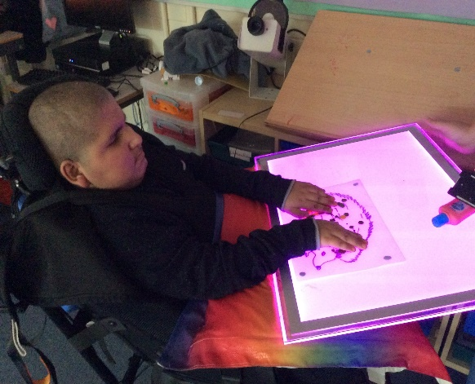
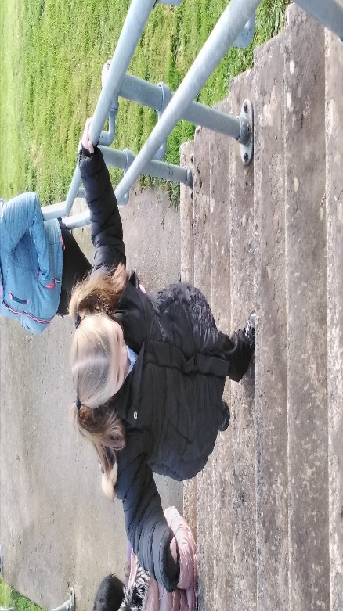
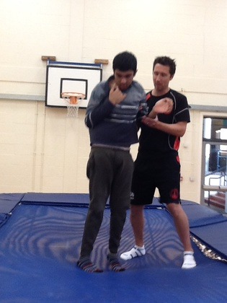
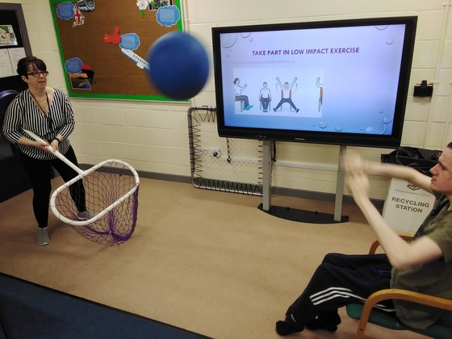
Look at what we can do:-

