Slide 1
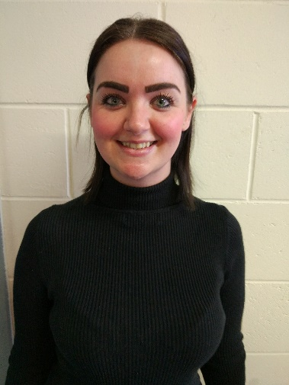
Welcome to Redwood Year 6 parents and carers ☺
Mrs Buckley Yr 7 Pastoral Lead M.S.B

Slide 2
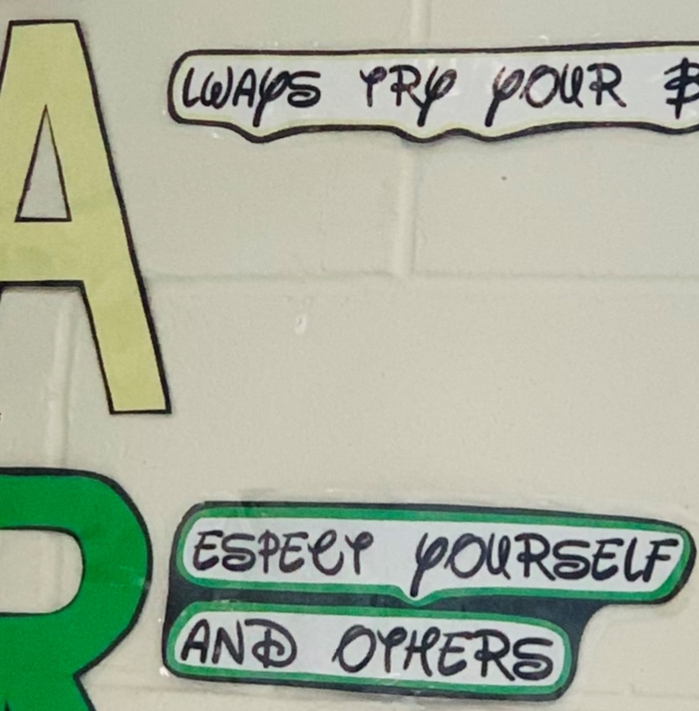
“Always try your best!” “Be kind to others.”

Slide 3
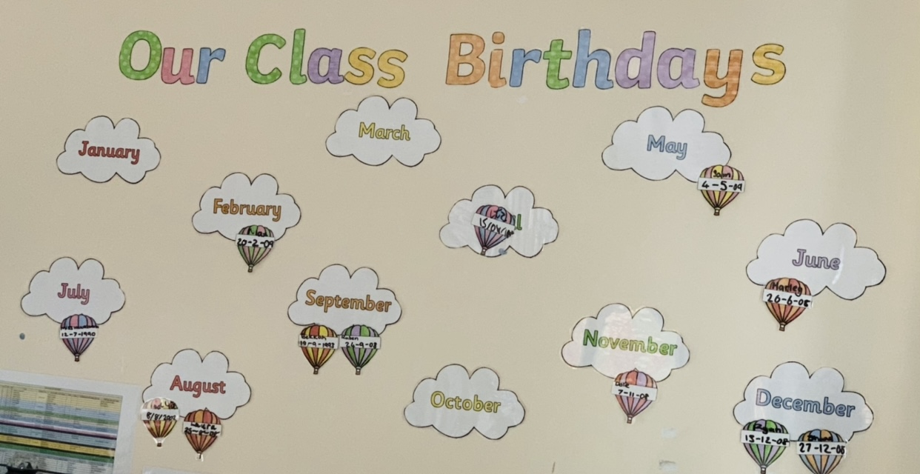
Birthdays and celebrations
A Child Centred Approach
-Your child is one of the most important people in this building.
-All our staff care so much for our students ! ☺
-Keeping them safe and happy.

Slide 4
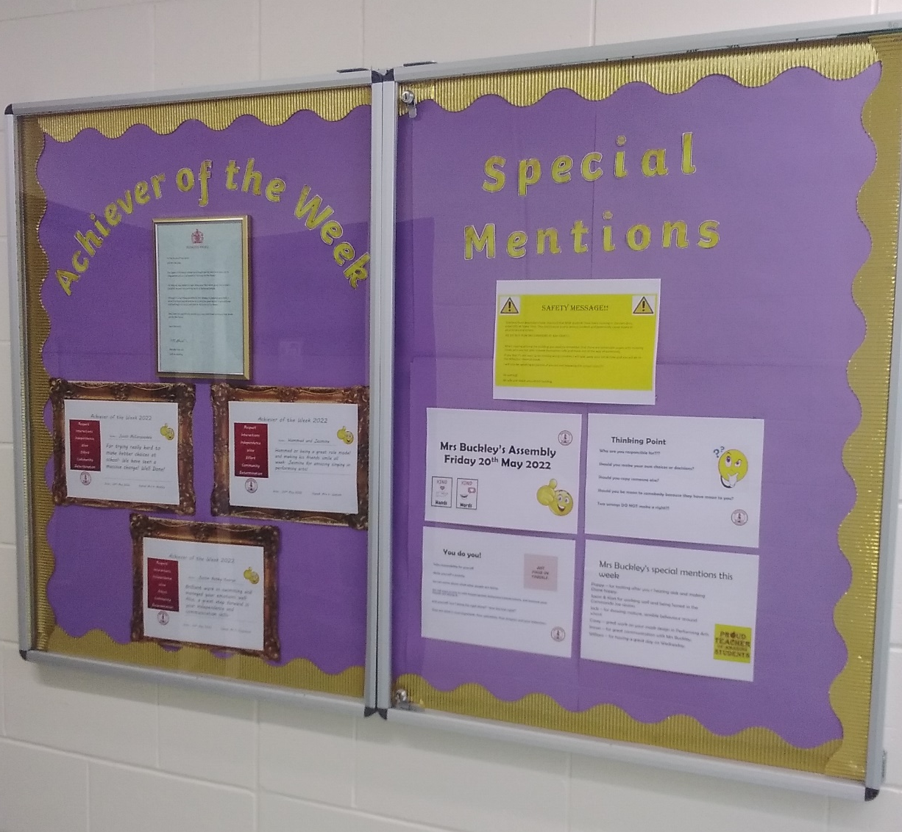
This is a very important and exciting year for you and your family!
We are looking forward to finding out your child’s wishes and dreams for the future and helping them to achieve them ! ☺

Slide 5
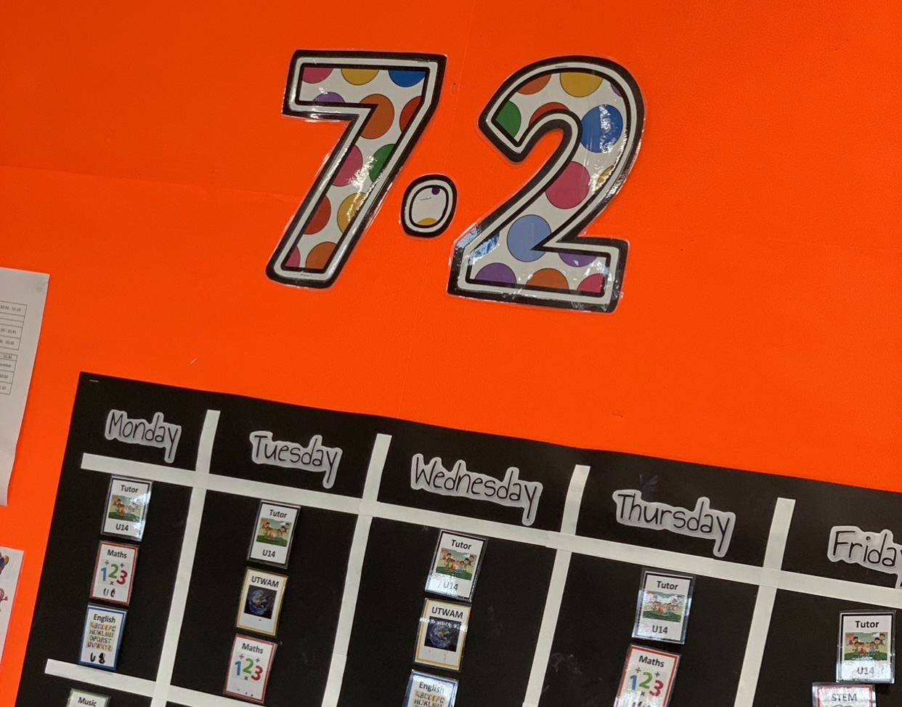
Visual help
-We use visual signs across the
school to help everyone find their
way around.
-Visual timetables.
-P.E.C.S. for support for non-verbal learners.

Slide 6
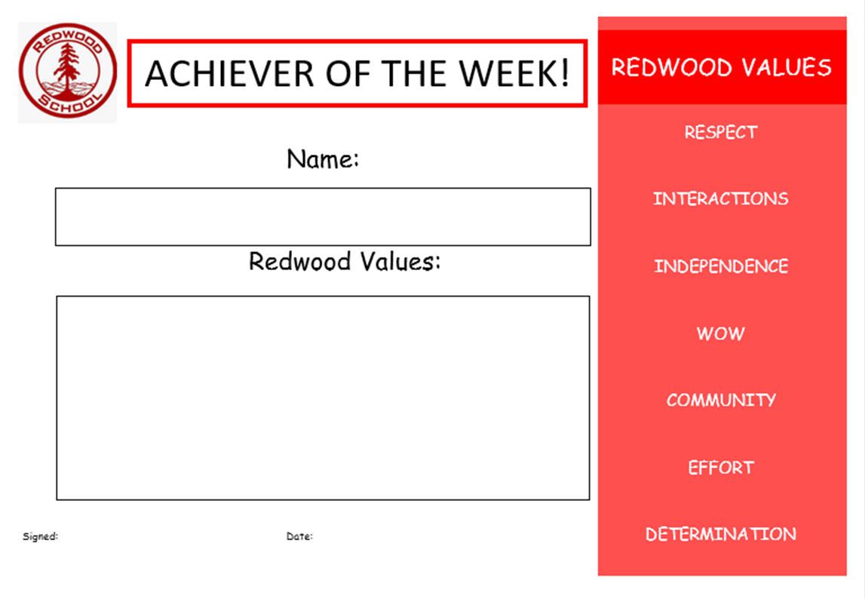
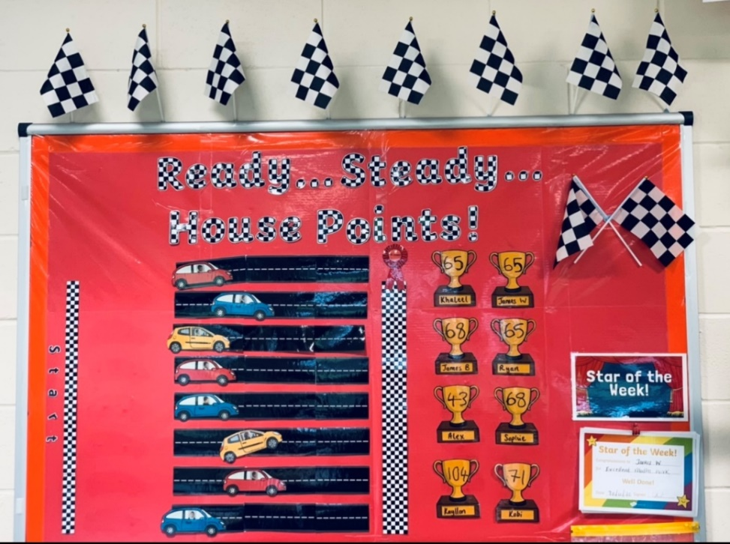
House points/ Redwoodian Award

Slide 7
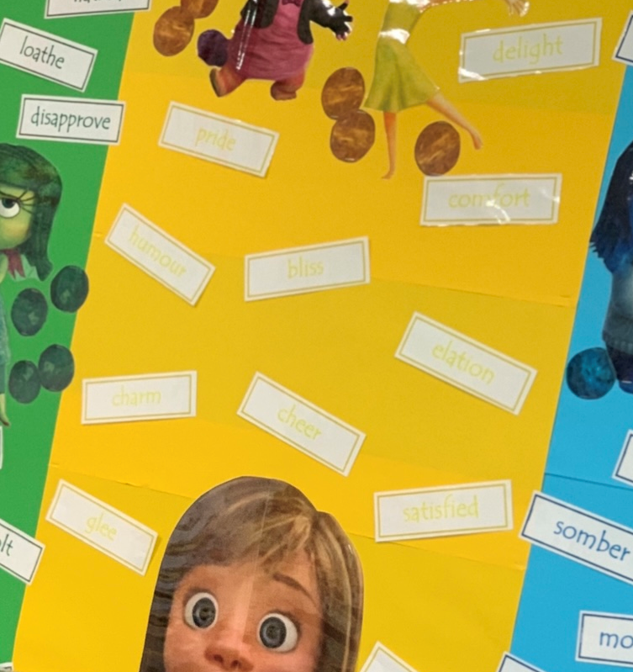
Emotions and well being
We are here to help!
Quiet spaces.
Sensory rooms/ sensory breaks.
Someone to listen. Intervention tutors.
Nurture.

Slide 8
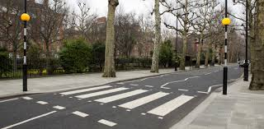
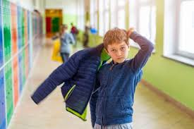
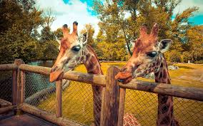
Lifeskills, Independence and Enrichment

Slide 9
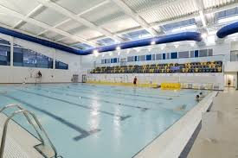
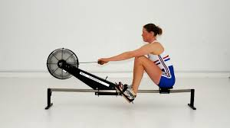
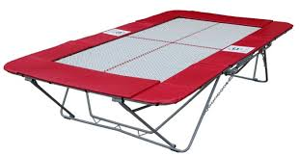
Being active !
Swimming
Trampolining
Indoor Rowing
Yoga and Aerobics
Football and many more!
Sports Day ☺

Slide 10
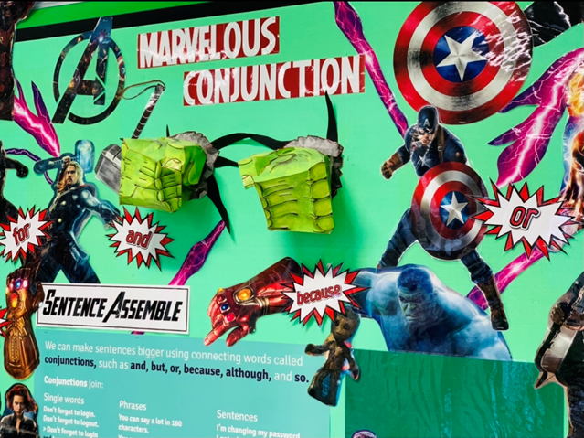
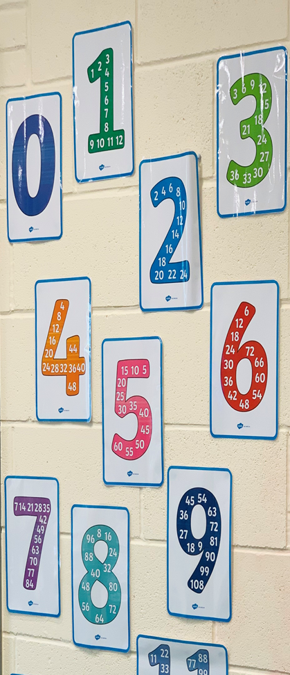
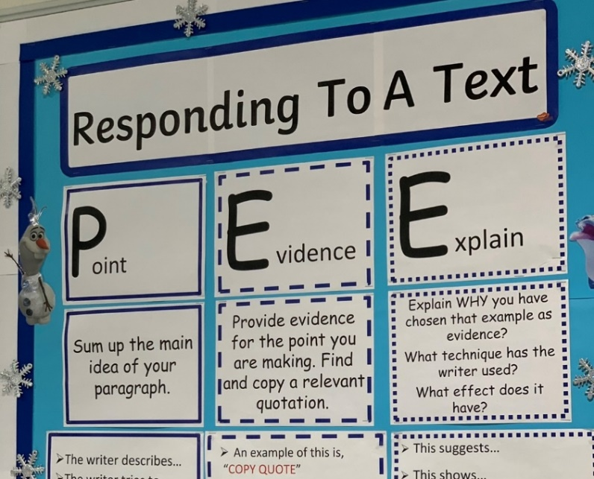
Numeracy and Literacy

Slide 11
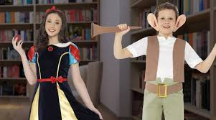
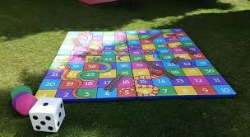
Curriculum Days are so much fun !

Slide 12
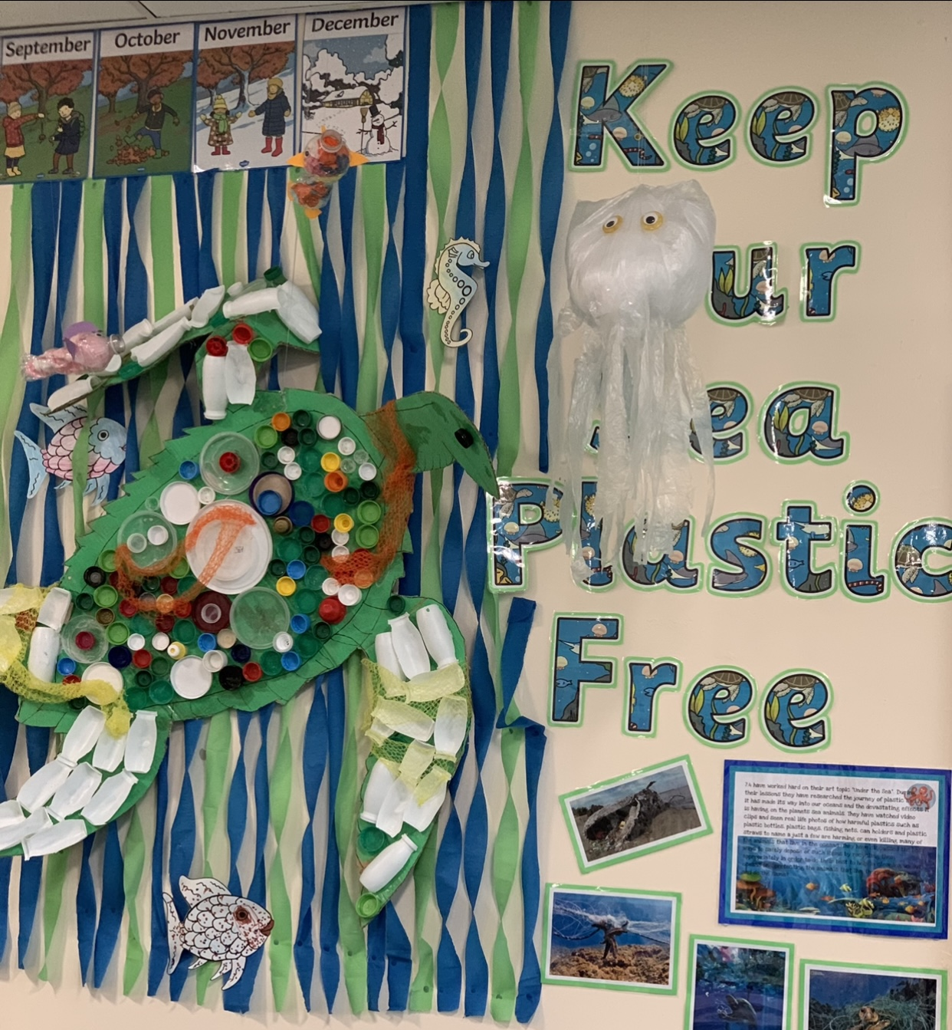
Understanding the World Around Me (UTWAM)
Different countries.
Different religions and cultures.
Inspirational people.
Looking after our planet.

Slide 13
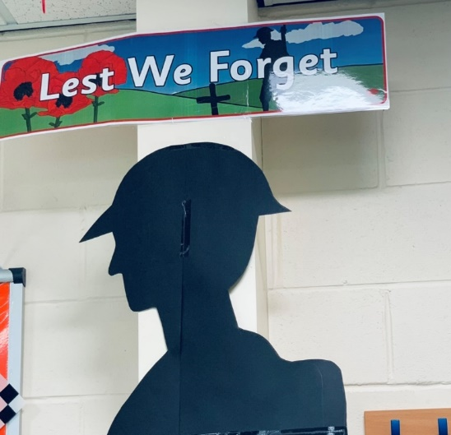
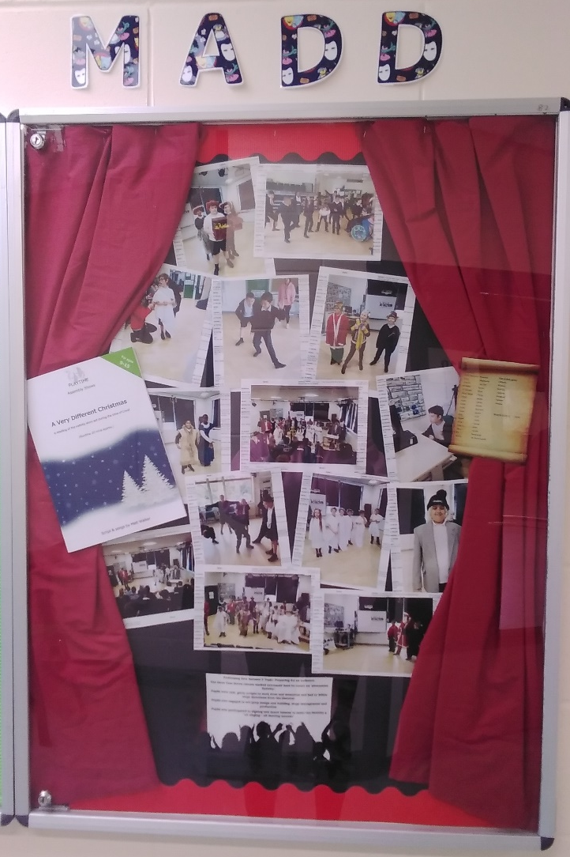
Creative (M.A.D.D)
https://www.youtube.com/watch?v=76mYGPeYy0c

Slide 14
We cannot wait to meet you and your families !
We know that your child will love being a part of our Year 7 at Redwood ☺
Keeley.buckley@redwood-school.com

